Slide 1
Reflecting on our settings based work
Wendy Halliday
Director
See Me

Slide 2

Create conditions where everyone can
Speak out without fear or judgement
Seek (and get) help when needed
Provide a confident, informed and compassionate response to someone seeking help
Directly challenge stigma and discrimination where it happens
Influence/ lead change and improvement
Experience fair and equitable access to and experience of the range of public services
Feel respected, valued and able to achieve the outcomes important to them

Slide 3

Stigma and discrimination in Scotland
Positive shift in the population
BUT NOT THE CASE FOR EVERYONE – in particular
People living with severe and complex mental illness
People who are racialised or marginalised
People struggling with their mental health and or in distress or crisis
Across the life course, Young people, adults and older adults
Stigma and discrimination likely to increase!
Social , economic and political factors
Communities, geography and identity
Across all public services
Notes:
Public awareness of mental health increased
More people aware we all have mental health and anyone can experience a mental health problem at any time
More people confident to talk about mental health (and reaching out for support)
More people sympathetic towards those who seek support.
More people confident to start mental health conversations with someone else
PPL with MI - face public and professional attitudes, prejudice, and gaps in knowledge and skills can lead to a person not disclosing or withdrawing and not getting the right help they need.
PP< who are marginalised face intersecting, structural and cultural stigma continue to experience higher levels of discrimination and face significant inequalities generally and when trying to access or benefit from services.
People who are struggling with their mental health and or in distress or crisis can find it difficult to know where to go for help, with many services not being available, accessible, suitable and/or taking account of individual or cultural needs, escalating this S and D experienced

Slide 4
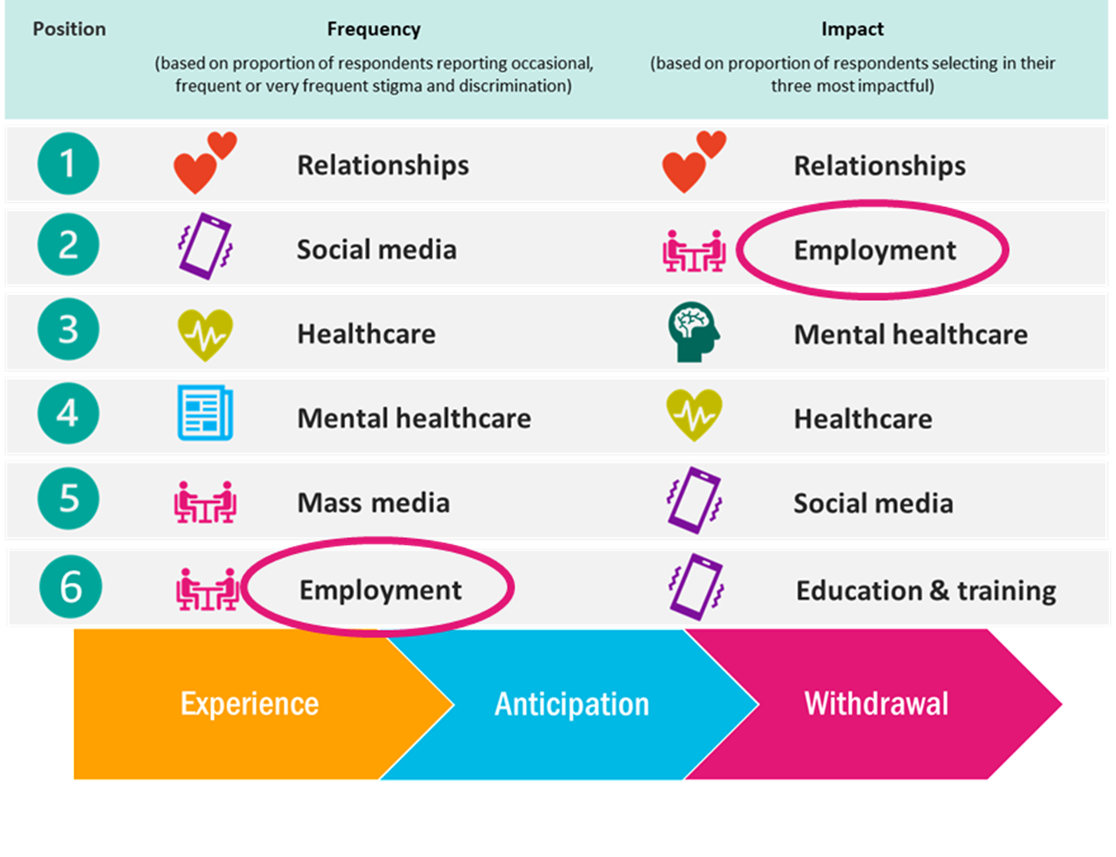
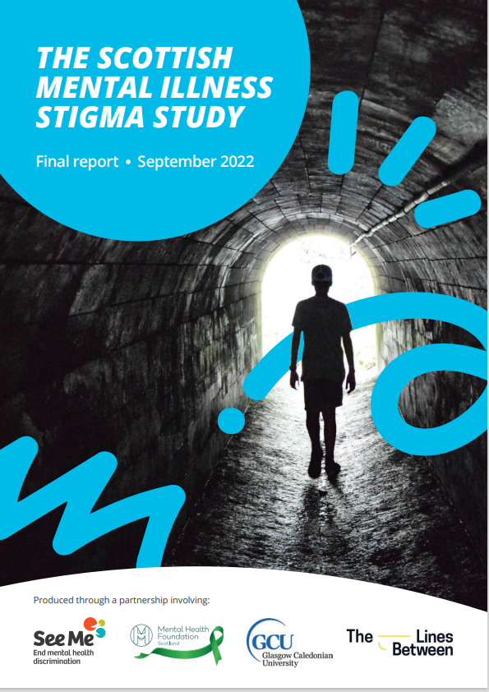
Data from the Scottish Mental Illness Stigma Study…
Notes:
People who identify as living with mental illness continue to be stigmatised and discriminated in 14 areas of their life

Slide 5

People with lived experience
Poorer quality of life and lower life expectancy
Face systemic marginalisation within all levels in the system
Face an imbalance of power in relationships when disclosing or making decisions about care and support; people often describe not being listen to, not taken seriously and being judged
Face structural stigma and discrimination (prejudice, negative attitudes and behaviours, exclusive processes and organisational cultures) in most institutions across different areas of their life
Describe how organisations/ service providers often fail to provide appropriate, personalised services or support sensitive to individual needs and circumstances.
Can have physical health conditions overlooked, misdiagnosed or inappropriately treated.
Remain unwilling to disclose to family, friends and/or colleagues that they have a diagnosed mental health condition.
Describe how the media, family members and carers can reinforce stereotypes with myths increasing stigma and discrimination

Slide 6

Priorities and projects in
2024- 26

Slide 7

Prioritising structural stigma and discrimination …
Legislation and Policy
  PSED – place of MH / dual and multiple S and D
  Inequalities in Health – Discrimination
Scrutiny and accountability
  MWC partnership – deep dive in 2026
  National Anti Stigma Collective (MHS Leaders)
  MH legislation
  Equality and HR Forum
  MH and W Leadership Board

Slide 8
Prioritising structural stigma and discrimination …
In practice
Embedding S and D in tests of change
    Time Space Compassion - SG/ SPS
    Distress Brief intervention
    MHS standards - HIS
    Place standards – PHS – Discrimination
Pilots of MH structural stigma (Canadian model)in local areas and MHS organisations

Slide 9
Building Capacity …
Partnership with NES
Intersectionality workshops and engagement
Diverse community engagement and empowerment
Reenergising See Me’s Social Movement
  PWLE – Volunteers and wider networks
  People across the system – mobilised and support to act

Slide 10

Settings …
Schools (secondary ) - See me See Change
Workplaces -See Me In Work
Health care -
FE and HE – undergraduate and as a whole system approach
Mental Health Services
Partnership with public services
  Police Scotland
  Scottish Ambulance Service
  NHS 24

Slide 11
Comms and PA …
Manifesto
Policy responses
Engagement with key (cross ) policy officials
Social media and website
Diverse lived experience across all channels
Campaigns – Time To talk day, If It’s OK?

Slide 12
Knowledge exchange, Research and evaluation
Global and UK alliance
Stigma series - events / networks
Research – SMISS , MH nursing
Share research and learning
Evaluation - focus on impact (ours and our partners)

Slide 13
Other work …
Supporting MH workplace network (SG and PHS)
Veterans and Female veterans
Partnership with Feniks and LGBT Health
Drug policy unit partnership
MH stigma and poverty
Partnership with PHS – intersectional stigma and discrimination
Partnership with VoX
Partnership with strategic equality partners and grassroots organisations
Arts fund

Slide 14
Going forward - Primary Areas of Focus
To tackle mental health stigma and discrimination through an intersectional approach

Slide 15
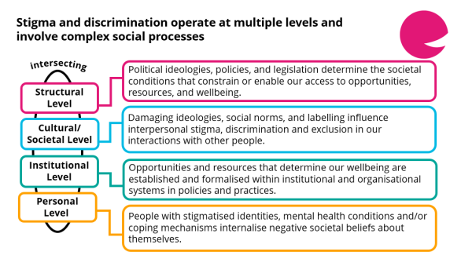

Slide 16
Primary Areas of Focus
Data GAP – National and local level data
MH/ mental illness
Equality data
Local and national
Population level data

Slide 17
Reflections…
Evidence based
Resources – budget
Partnerships
Learning
Impact!

