Slide 1

Session 2
Systemic Racism and Mental Health Stigma
Lucien Staddon Foster
Coalition for Racial Equality and Rights (CRER)

Slide 2
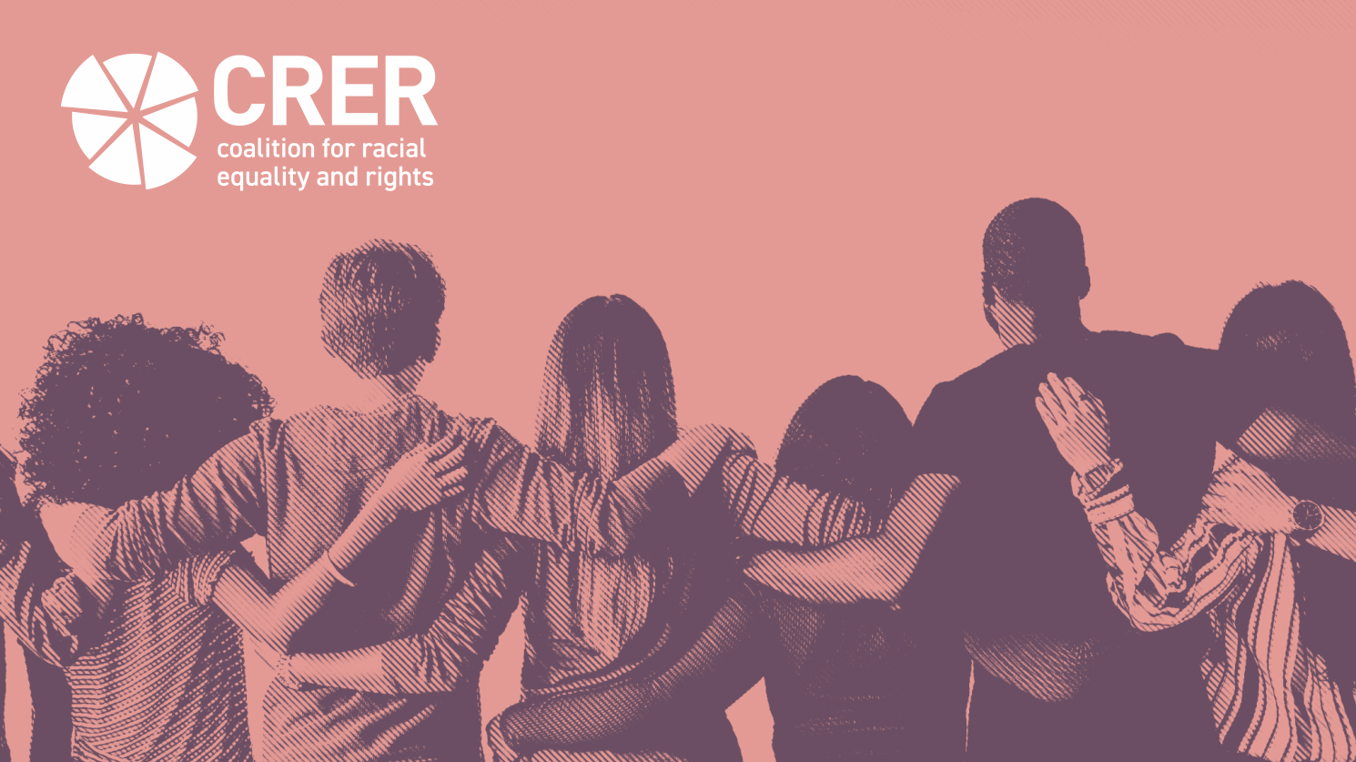
Systemic Racism
and Mental Health Stigma

Slide 3
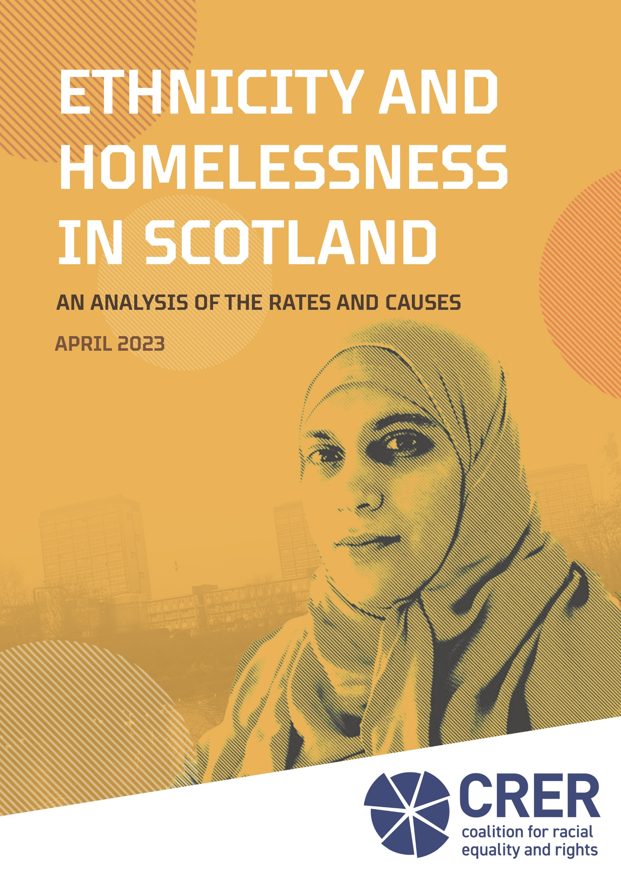


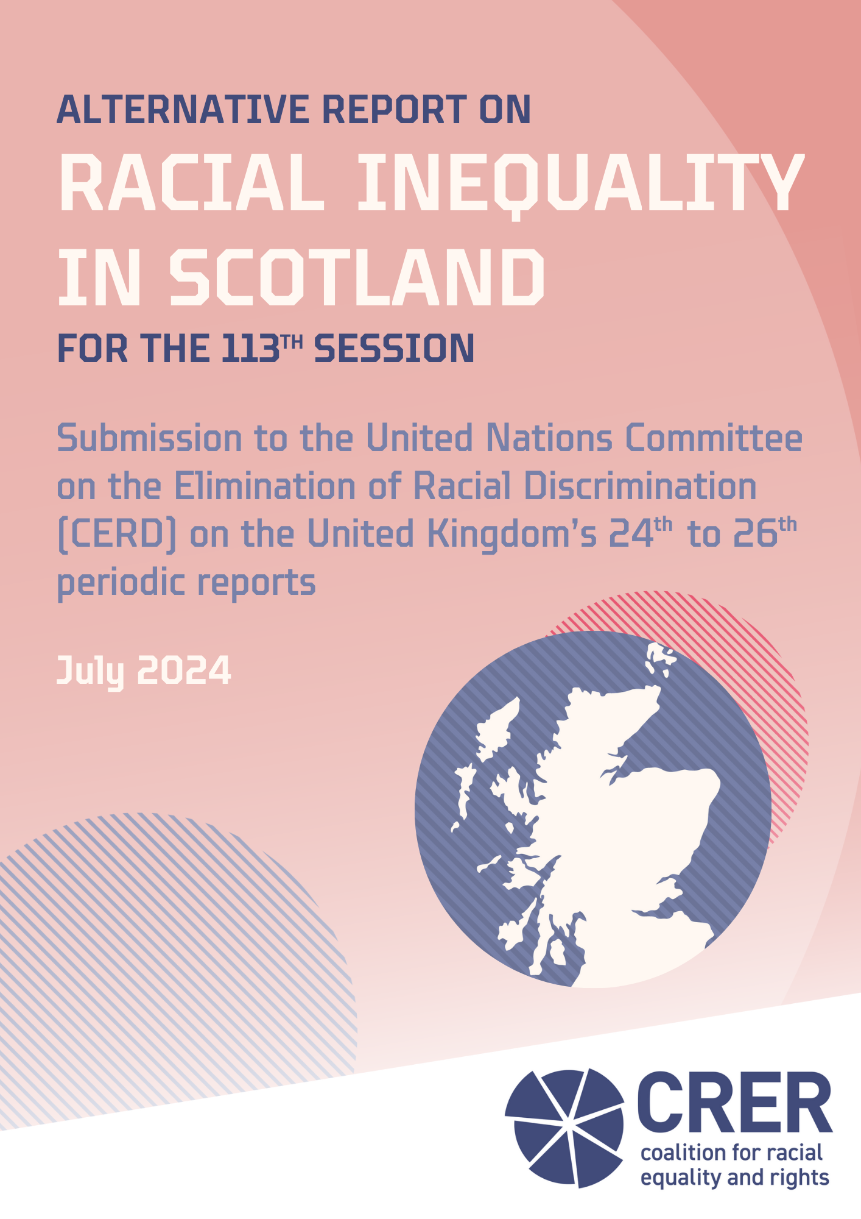
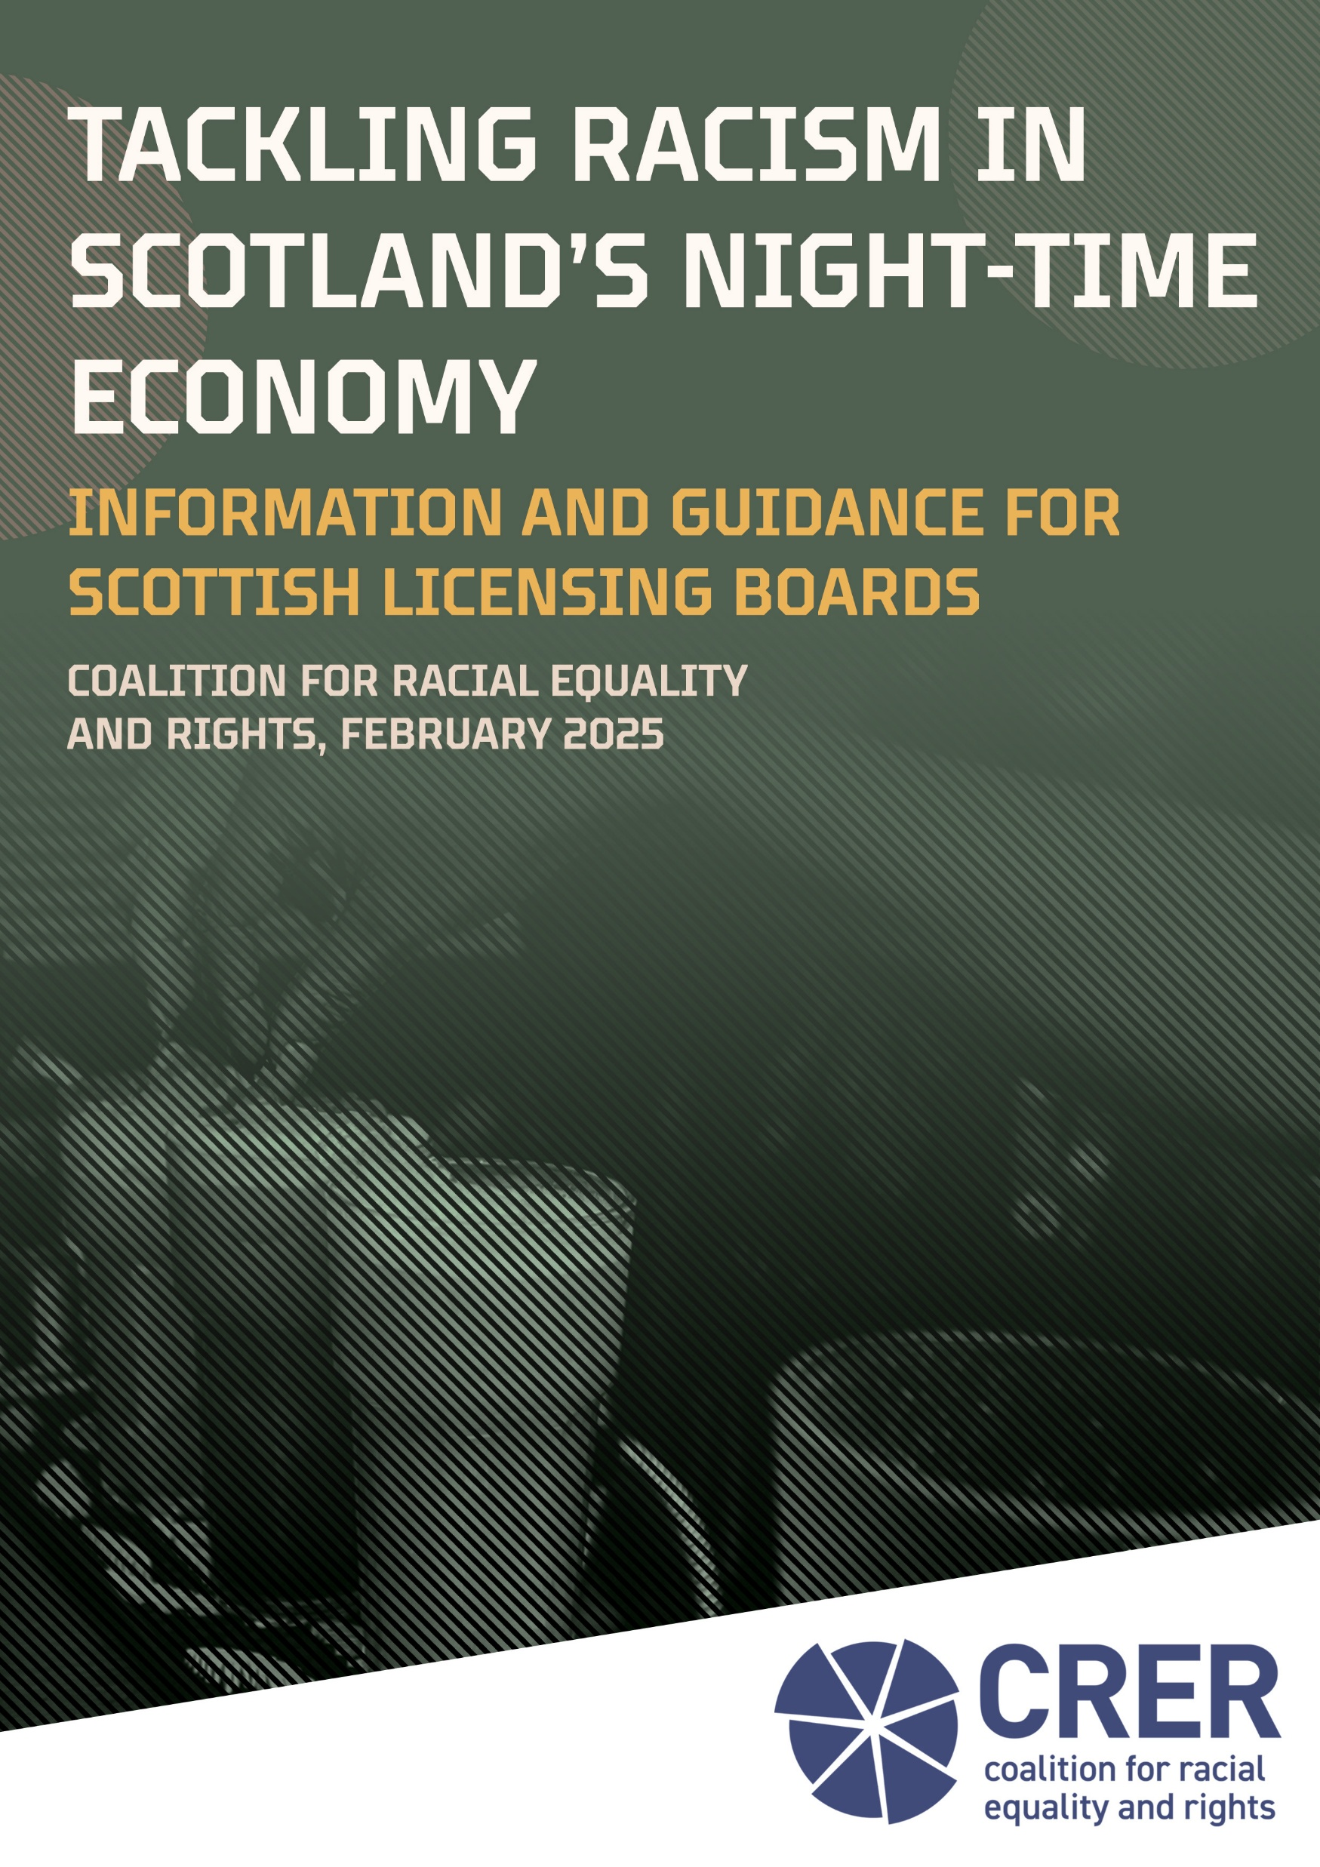
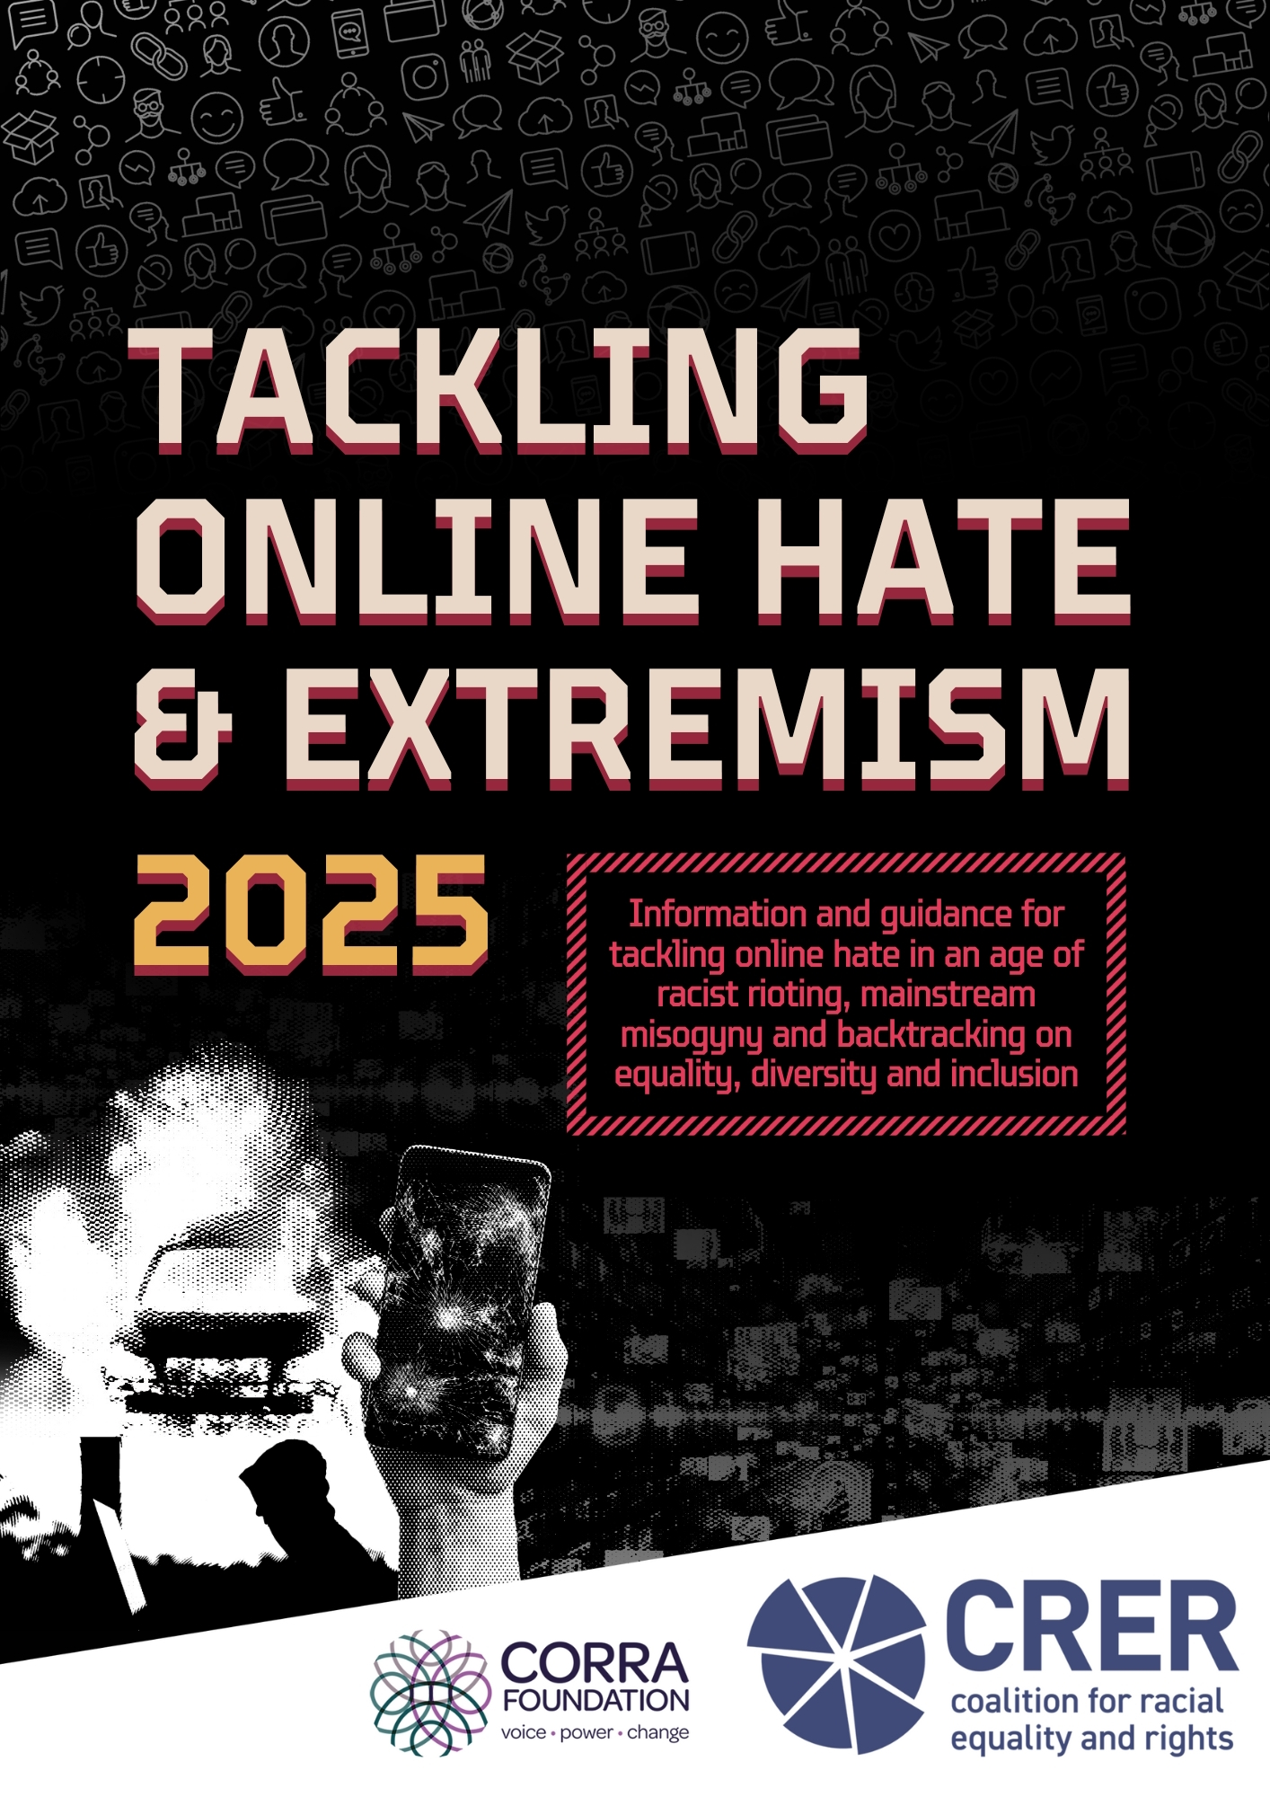
Who we are
CRER is a strategic anti-racism charity based in Glasgow
Since 1999, CRER has been working to eliminate racial discrimination and promote racial justice across Scotland
Our work spans research and policy advocacy, working with public bodies and the third sector to promote anti-racist principles in the design and delivery of services

Slide 4
Who I am: Lucien Staddon Foster
Research & Policy Officer at CRER, leading on our work on racialised mental health inequalities. I specialise in using equalities data to investigate systemic racism in Scotland
Understanding systemic racism
Systemic racism and mental health
Re-thinking intersectional stigma
Notes:
Today, I’m going to be focusing on three key areas:
Understanding systemic racism
Understanding racialised mental health inequalities in Scotland
Re-thinking intersectional stigma

Slide 5




Understanding racism: Interactions and attitudes
Racism works at different levels to affect the experiences and outcomes of Black and minority ethnic groups
Interpersonal racism
Social (cultural) racism
Notes:
When people think about racism, they generally think about harmful day-to-day interactions and the types of attitudes that result in racial bias and stereotyping
This describes interpersonal racism – which can take a range of direct and indirect forms, including racist abuse and the use of dehumanising language, to more subtle expressions of prejudice like micro-aggressions
Racist views, attitudes and biases can also become culturally embedded to the point where society perceives the importance and value of one ethnic group’s identity, appearance, culture and way of life above others.
This describes social (or cultural) racism, which contributes to a sense of superiority over the traditions, cultures and practices of the dominant ethnic group, based on the assumption that this viewpoint is the right and best way. Everything else is treated as an anomaly.

Slide 6
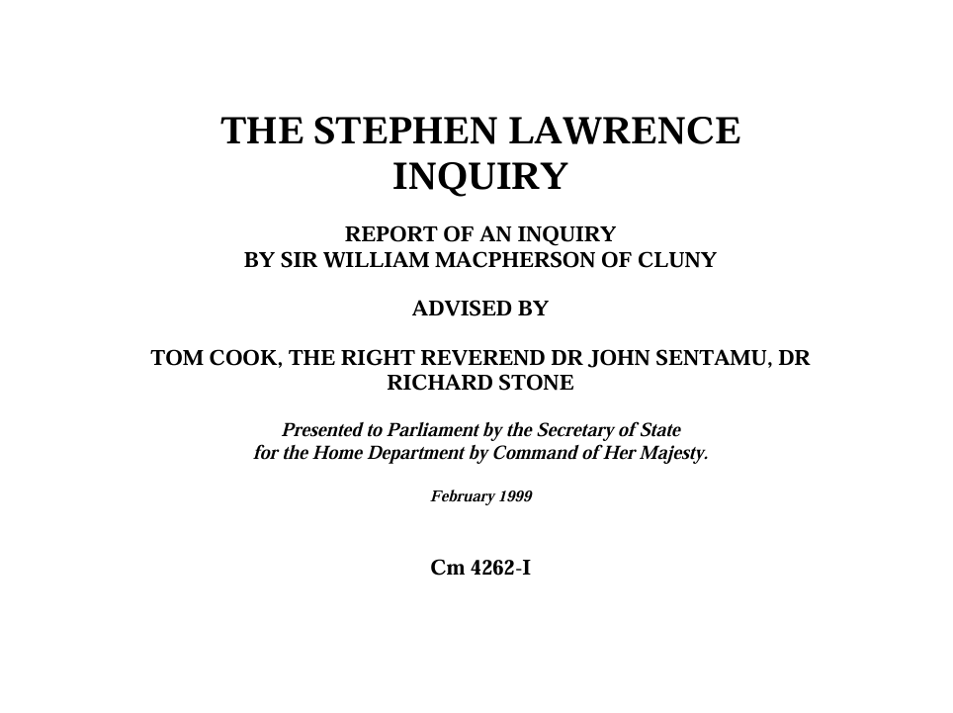
Understanding stigma: Policies and processes
“The collective failure of an organisation to provide an appropriate and professional service to people because of their colour, culture or ethnic origin”
“It can be seen or detected in processes, attitudes and behaviour which amount to discrimination through unwitting prejudice, ignorance, thoughtlessness and racist stereotyping which disadvantage minority ethnic people”
Institutional racism
Notes:
These attitudes and biases inform the ways that we do things, including how institutions prioritise their work, design their policies and approach decision-making.
Racism becomes an institutional matter. It becomes – as the Stephen Lawrence Inquiry’s Macpherson Report put it – a “collective failure of an organisation to provide an appropriate and professional service to people because of their colour, culture or ethnic origin.”
In an unfair, institutionally racist system, those from Black and minority ethnic backgrounds are likely to have worse experiences and outcomes than their white counterparts

Slide 7

Understanding racism: Systems-level inequality
At a societal level, racism works to embed the unequal distribution of power, resources, privilege and safety across the full range of economic, political, social and cultural structures that define our system
Structural racism
Notes:
This manifests at a societal level to embed the unequal distribution of privilege, resources, safety and power across the full range of economic, political, social and cultural structures that define our system.
For these reasons, we understand racism as a ‘structuring’ or ‘systemic’ force in our society – something that works to shape Black and minority ethnic people’s outcomes in employment, education, health, criminal justice, political representation and more.

Slide 8


Understanding racialised mental health inequalities in Scotland
Notes:
If we want to understand mental health inequalities in Black and minority ethnic communities, we need to consider the drivers of poor mental health and what contributes to stigma and gaps in service provision
To do this, we need to understand racism and how exactly it shapes people’s experiences and outcomes across society.

Slide 9
The Dominant Assumption: Cultural Stigma
“Additional stigma surrounding mental health problems and illness exists within marginalised communities primarily due to 'cultural reasons', which is the biggest barrier to accessing services. Therefore, we need targeted, tailored interventions to enable marginalised groups to talk about mental health, learn about and access existing services”
Above example common to mainstream anti-stigma campaigns (Kapadia, 2023)
Notes:
The mainstream approach to understanding mental health inequalities falls short of this.
Time and time again, discussions about racialised mental health inequalities are centred around notions of community stigma
This recognises the role that cultural attitudes and fears about ‘opening up’ can play in shaping Black and minority ethnic communities’ experiences of stigma
It also suggests that the solution is to intervene in the community, so that they can better access mental healthcare services
However, this only recognises part of the problem and places all of the responsibility on communities themselves

Slide 10














Interpersonal and social:
The dominant assumption only recognises this
Interpersonal
racism
Community
safety and cohesion
Vicarious
trauma
Cultural
stigma
Institutional:
Disproportionate
detention
Stop and
Search
Access to
healthcare
Language &
terminology
Inadequate
services
Structural:
Racialised
poverty
Housing
inequality
Employment
inequality
Cultural
distance
Access to
green space
This systems map does not intend to be exhaustive
Notes:
If we want to understand racialised health inequalities, it can be helpful to break it down into its constituent parts, driven by different forms of racism in society
Based on the evidence I work with, I’ve pulled together a basic systems map of racialised inequalities in mental health
The dominant assumption recognises cultural stigma as the leading cause of intersectional stigma within Black and minority ethnic communities. This way of thinking completely neglects the significant roles that racism and racial inequality play in shaping people’s mental health and their experiences of stigma

Slide 11
Drivers: Interpersonal and social
Experiences of interpersonal racism and people’s vicarious exposure to it can have an extremely negative impact on mental health
People from Black and minority ethnic backgrounds are much less likely to feel like they belong in their local communities
Notes:
Black and minority ethnic people’s experiences of racism – and their exposure to it - can significantly impact their mental health.
A recent study by Professor Nasar Meer found that 35% of BME people in Scotland have faced discrimination in the past two years, and every week, communities are exposed to huge amounts of racial hatred in the media, online and in our streets. Where is the recognition of this within Scotland’s mental healthcare sector?
Linked to this, the latest Scottish Household Survey found that respondents from BME backgrounds were more than 20 percentage points less likely to feel that they belonged in their local communities
Scottish responses to the Evidence for Equality National Survey show that all BME groups were more likely to say they felt lonely in the past week than white Scottish/British respondents
How does the sector consider this context?

Slide 12
Drivers: Institutional
BME groups face higher rates of involuntary detention in the Scottish mental healthcare system and are more likely to be considered dangerous or problematic
Scotland’s mental health services have not been designed with the experiences and needs of BME communities in mind – they do not meet their needs
Notes:
In 2021, the Mental Welfare Commission for Scotland found that people from African, Chinese and Mixed backgrounds were at a higher risk of being detained under the Mental Health Act compared to white Scottish people. They found a 4.8 times greater likelihood of using compulsory treatment.
People from BME backgrounds were also more likely to be considered a risk to other people, as opposed to just themselves, which shaped the types of response they are subjected to in healthcare settings
This echoes wider societal trends, where people from Black and minority ethnic backgrounds are treated as more dangerous or problematic than their white counterparts due to racist stereotypes and biases. For instance, we know that people from African, Caribbean and Black ethnic backgrounds in Scotland are twice as likely to be stopped and searched by the police as white Scottish people and are disproportionately subject to police use of force
These experiences – and knowledge of their existence – can create significant stigma due to fears about how people will be treated by the system
Scotland’s mental health services often fall short of adequately supporting BME groups due to gaps in how they have been designed and an over-reliance on models of care and service provision that are less accessible, effective and relevant for BME communities
Does the sector recognise how this contributes to intersectional stigma?

Slide 13
Drivers: Structural
BME groups are more than twice as likely to live in poverty after housing costs as their white Scottish/British counterparts
For some groups, especially recent migrants, asylum seekers and refugees, it can be incredibly difficult to navigate differences between the cultural contexts they are used to compared to Scotland
Notes:
Today, we widely recognise that there are social determinants of mental health, such as people’s experiences of poverty or poor quality and insecure housing.
In Scotland, BME groups are more than twice as likely to live in poverty as their white Scottish counterparts
According to the Scottish Household Survey, BME groups are more likely to struggle to pay their housing costs and worry that they have to move homes because of this. Because of systemic racism, BME groups are also more likely to live in overcrowded and poor-quality homes
When the sector considers the social determinants of mental health, how does it consider the racialised nature of these inequalities?
It is also important to consider the role of ‘cultural distance’, which describes the challenges associated with navigating the differences between someone’s country of origin, or the cultural context they are most familiar with, and ways of doing things in Scotland.
This can contribute to feelings of instability, uncertainty and a lack of confidence when navigating life – contributing to higher rates of stress and anxiety, and has been cited as a driver of disproportionate rates of psychosis in BME communities
Additional support – and increased empathy – is needed to support people going through this process, but this is missing from the mainstream ways of doing things
Is this context widely recognised in the sector? Is this widely recognised in Scotland?

Slide 14
Interpersonal and social:
Interpersonal
racism
Community
safety and cohesion
Vicarious
trauma
Cultural
stigma
Institutional:
Disproportionate
detention
Stop and
Search
Access to
healthcare
Language &
terminology
Inadequate
services
Structural:
Racialised
poverty
Housing
inequality
Employment
inequality
Cultural
distance
Access to
green space
This systems map does not intend to be exhaustive
Notes:
Turning back to the systems map, it is clear that the dominant narratives of intersectional stigma are incredibly reductive
So, how can we – as a sector – do things differently?
When thinking about stigma, how do we ensure these

Slide 15
Re-thinking stigma
What assumptions are being made when we think ‘cultural stigma’ is the leading barrier to care?
How can the sector recognise its role in creating and entrenching stigma?
Are there barriers that prevent us from taking a different approach?
Notes:
If we want to ‘shift the dial’ and re-think stigma, how do we break the cycle of only recognising cultural stigma?
How do we as a sector recognise our own responsibility, and the wider roles that racism and intersectional discrimination play?
What are some of the key barriers that prevent us from taking a different approach?

Slide 16



Centring lived
experience
Taking an
anti-racist
approach
Improving
ethnicity data
Notes:
There are clearly a wide range of changes that can be made, including different ways of thinking and specific operational improvements in how the sector does things?
Drawing on my work, I’ve identified these key principles that can guide how to better understand and challenge intersectional stigma:
WE MUST CENTRE LIVED EXPERIENCE – through sharing power, through targeted engagement and meaningful involvement, through co-produced and community-based services, through employing a representative workforce
TAKING AN ANTI-RACIST APPROACH – by taking an anti-racist approach, we can understand our roles in perpetuating racial inequality and identify the actions needed to tackle it. This is a long-term commitment to changing how we do things to prevent racial inequality. Anti-racism describes the journey to race equality, not the destination. We all have a duty to challenge the denial of racism and take steps to tackle racial inequality
IMPROVING ETHNICITY DATA – by improving the collection and analysis of statistics by ethnicity, we can identify where inequalities exist and highlight areas for targeted action. This will improve understandings and the responsiveness of policy approaches

Slide 17
In closing
www.crer.org.uk
lucien@crer.org.uk
Our current approaches ignore racial inequality, undermining their impact
We need to think differently if we want to break the cycle – “The Master’s Tools Will Never Dismantle The Master’s House”
If this was useful or interesting, mark your diaries for 20th November 2025, where I’ll be launching the research that underpinned this session

