Slide 1
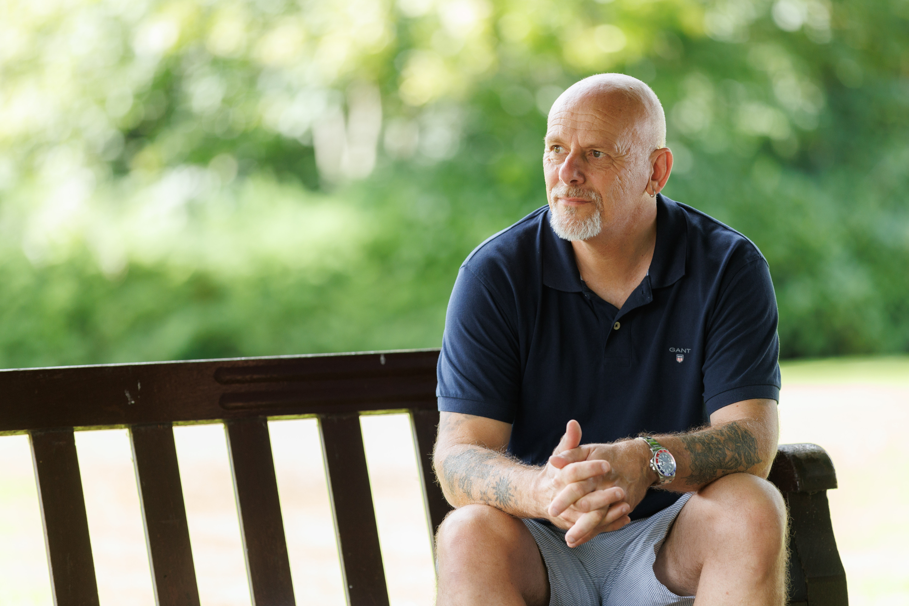

Leading from Experience:
Structural Stigma and Peer Support
Christopher Nicolson
Robert Nesbitt

Slide 2

Physical Activity & Sport and See Me
Co-creation of Resources
SAMH, See Me, and Paths for All jointly developed a toolkit and training resource to support mental health-inclusive community walks.
No More Shame
See Me, Combat Stress and SAMH have been awarded funding from the Armed Forces Covenant Trust on a new partnership project, to understand the nature of mental health stigma and discrimination experienced by women veterans in Scotland and take forward work on how to tackle it.
Community Engagement and Peer Support
Both organisations support community-led action to tackle stigma. They focus on empowering individuals with lived experience to lead change in their local areas. This includes training and capacity-building to help people feel confident discussing mental health in physical activity settings

Slide 3
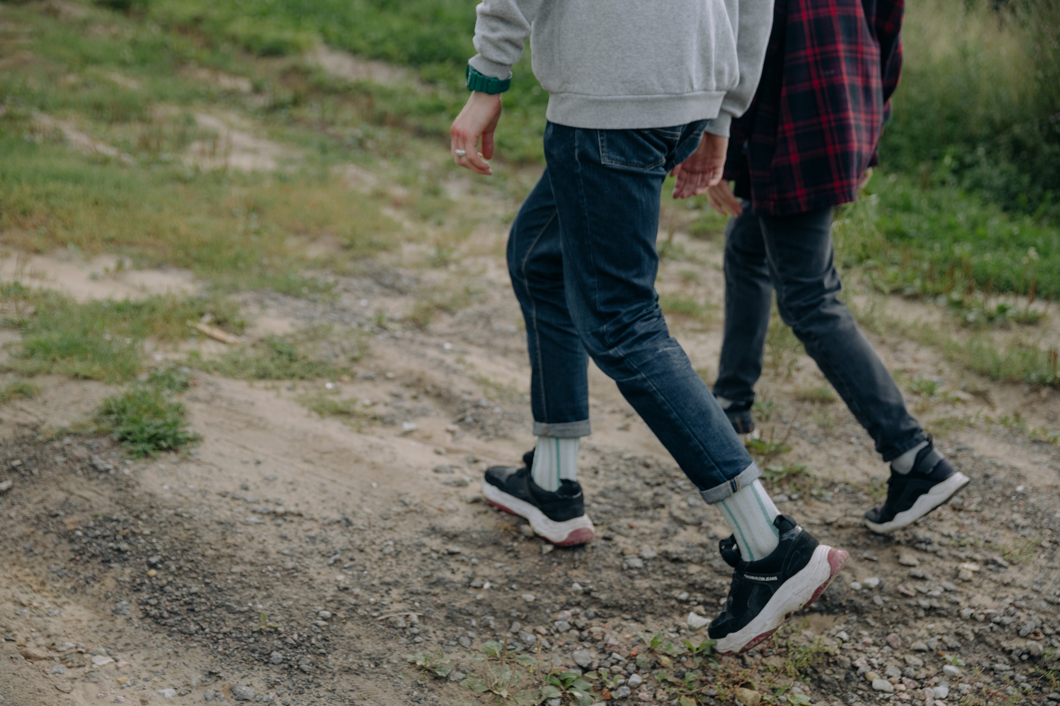
What we have learnt with working with SeeMe….
Explore
Challenge
Sharing Knowledge
Create
Progress
Question

Slide 4
Workshop Objective​
Explore how peer engagement and peer leadership challenges various forms of mental health stigma.
Interactive Learning​
Engage participants through activities, case studies, group discussions and sharing of experiences to deepen understanding.​
Empowerment and Reflection​
Encourage reflection to empower participants to identify stigma and support lived experience leadership.​
Group Agreements
  Safety
  Respect
  Confidentiality
  Value all voices

Slide 5

Definitions
Stigma is a set of negative beliefs, attitudes, and behaviours directed toward individuals or groups based on perceived differences, such as mental health conditions, disabilities, race, gender, or lived experiences.
Structural stigma refers to the ways in which societal systems, institutions, policies, and practices disadvantage or marginalize individuals or groups based on characteristics such as mental health status, disability, race, gender, or lived experience.
Self-stigma occurs when individuals internalise the negative stereotypes and prejudices held by society about their identity, condition, or experiences—such as mental health challenges, disability, or substance use.

Slide 6
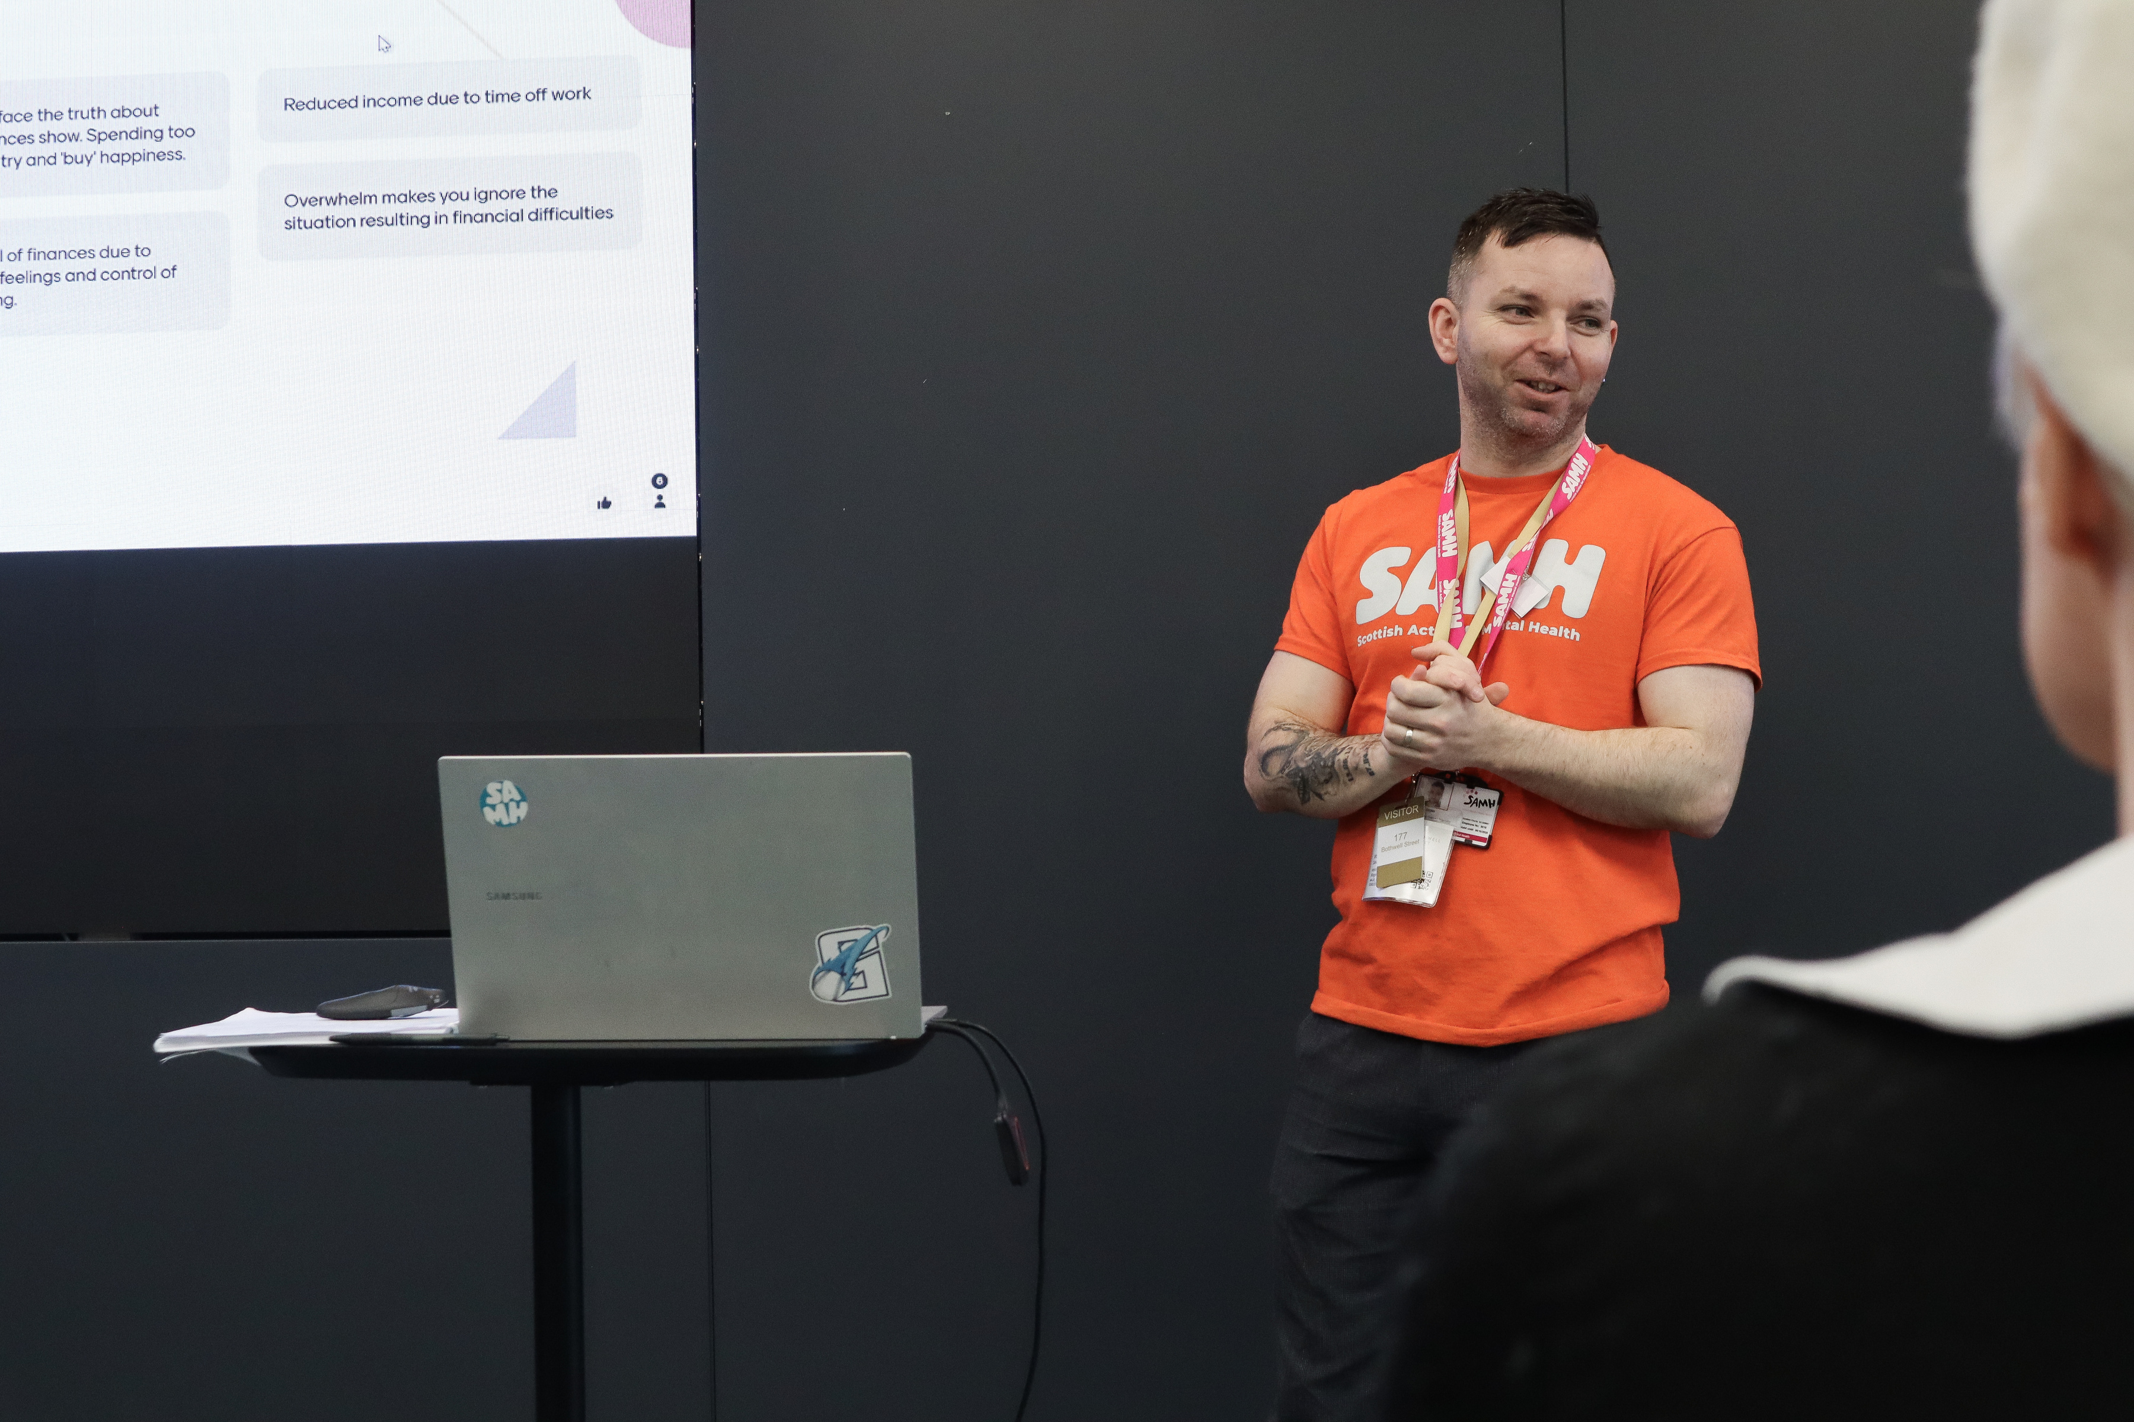
Consider & Discuss
Reflect on an occasion when you or someone you know were treated differently.
  What happened?
  What were your thoughts and feelings?
  What was the outcome?
  How did that shape you and your views about stigma?

Slide 7
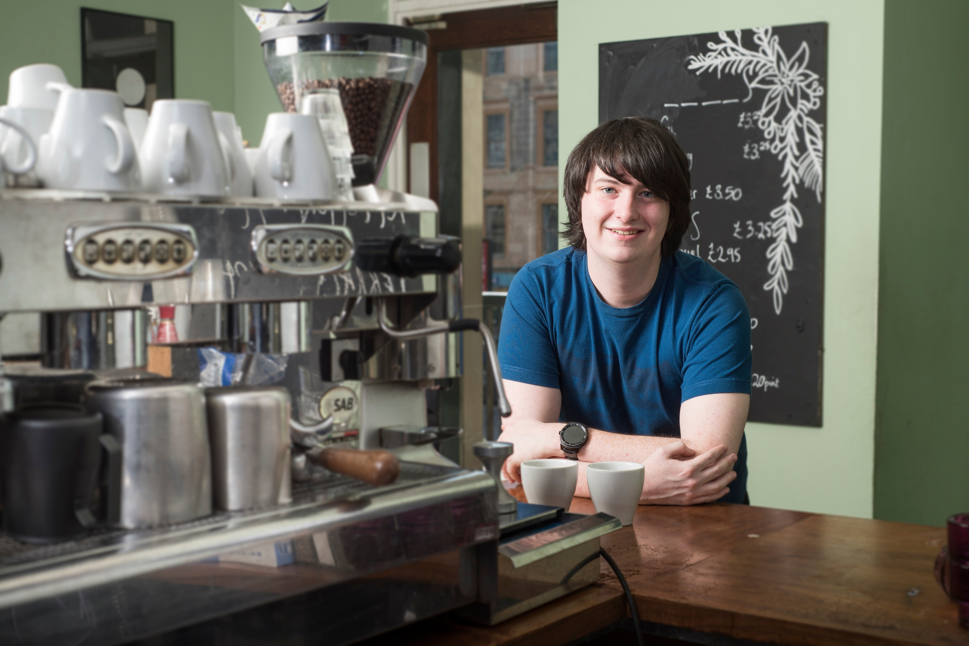
Structural Stigma
How Structural Stigma might exist in a peer setting?
Systems
  People with diverse lived experience are underrepresented in leadership and decision-making.
  Care pathways can be fragmented, making support hard to access.
Programmes
  Peer roles may be tokenistic, with limited influence or leadership.
  Programmes may be designed without co-production, making them less relevant.
  Short-term funding undermines sustainability of peer-led initiatives.
Practices
  Facilitators may hold unconscious biases or stigmatizing attitudes.
  Lack of trauma-informed care can lead to re-traumatisation.
  Communication styles and environments may not be inclusive or empowering.

Slide 8
Structural Stigma
What might we do to address this?
Systems
Programmes
Practices
In Your Groups
Focus on each of the Key Areas
Explore what you think can be done to address structural stigma?
What are the key factors to consider?
What is needed to support change?
What resources might we need?

Slide 9
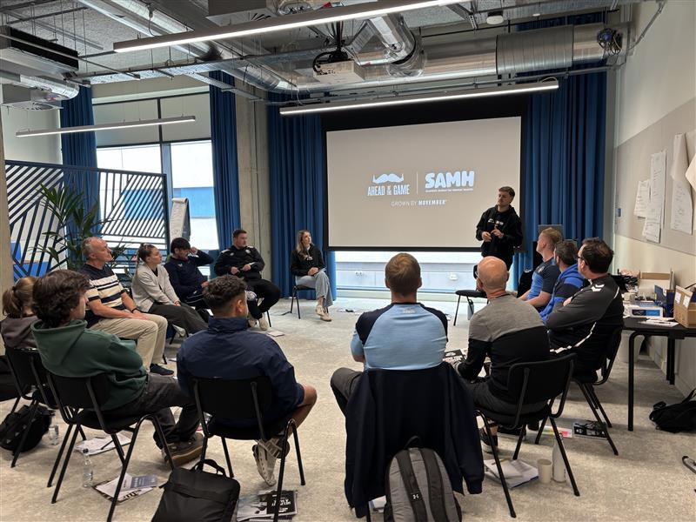
Structural Stigma
How we address these issues
1. Leadership Commitment and Accountability
Visible leadership
  Acknowledging stigma and commits to change.
  Embedding anti-stigma goals into strategic plans, KPIs, and governance structures.
  Accountability mechanisms (e.g. audits, reviews, reporting) to track progress.
2. Co-production and Lived Experience
  Involve people with lived experience in the design, delivery, and evaluation of programmes.
  Shift from tokenistic consultation to genuine co-production.
  Create safe spaces for storytelling and testimony that challenge dominant narratives.
3. Policy and Practice Reform
  Review and revise policies that reinforce stigma (e.g. exclusionary eligibility criteria, punitive language).
  Embed inclusive, trauma-informed, and rights-based approaches.
  Ensure intersectionality is considered—how stigma compounds across race, gender, disability, etc.
4. Workforce Development and Culture Change
  Provide training on unconscious bias, stigma, and inclusive practice.
  Support reflective practice and supervision to challenge internalised norms.
  Promote diverse recruitment and leadership pathways.
5. Data, Evidence and Evaluation
  Collect and use disaggregated data to identify where stigma manifests.
  Evaluate programmes for unintended consequences that may reinforce stigma.
  Use qualitative insights alongside quantitative metrics to capture lived realities.
6. Communications and Narrative Shift
  Challenge stigmatising language and imagery in public messaging and internal documents.
  Promote asset-based narratives that highlight strengths and resilience.
  Engage media and influencers to reshape public discourse/attitudes.
7. Collaboration and Partnerships
  Working together across health, education, justice, housing, and community sectors to tackle stigma systemically.
  Share learning and align efforts to avoid siloed approaches.
  .

Slide 10
Structural Stigma
How we address these issues
Systems
  Peer panels have been utilised to influence system discussions and actions
  Where possible, self-referral is encouraged and barriers are identified and addressed in system design
Programmes
  Co-design and Co-production at the heart of all PA&S programmes
  Peers are supported using person-centred approaches - case studies to follow!
  Peer leadership is considered as a long-term solution beyond programme deliver
  Value of Peer Led Community Groups and structures leading on and attracting own funding opportunities.
Practices
  Training provided across programmes to maintain fidelity in practice
  Staff in PA&S trained to foster inclusivity and person-centred approaches.

Slide 11

PA&S Case Studies
"The lads from The Changing Room have a WhatsApp group and we chat about everything, even laugh about it. Mental health is not a taboo subject anymore, we’re just chatting away. Five years ago that would have been so embarrassing for me, but the last two years have been the best time of my life.”
Steve from Falkirk
Time Space Compassion
5. The Changing Room (SAMH) - Time Space Compassion - supporting people experiencing suicidal crisis: stories in practice - volume 1 - gov.scot

Slide 12
What is a ‘Safer Space’?
In your groups
Consider if you or people you work with wanted to talk about the structural stigma experienced….
How would we create the right conditions to establishing safer spaces…
      What would you want this to be like?
      what a safe space would look like?
      What would you want it to feel like?
      What would be needed to create a safe space?
  .

Slide 13
Clinical Space & Community Space
Aspect | Description
Environment | Structured, formal, often medical or therapeutic setting.
Focus | Diagnosis, treatment, recovery, and measurable health outcomes.
Leadership | Led by healthcare professionals (e.g., doctors, therapists).
Access | Often requires referral, appointment, or eligibility criteria.
Approach | Evidence-based, protocol-driven, risk-managed.
Participant Role | Often passive or patient-focused; receiving care.
Monitoring | Regular assessments, clinical metrics, and documentation.
Confidentiality | High level of privacy and data protection.
Cost | May be covered by healthcare systems or insurance.
Stigma Risk | Higher due to association with illness or disability.
Aspect | Description
Environment | Informal, inclusive, and socially engaging.
Focus | Empowerment, wellbeing, social connection, and participation.
Leadership | Led by community workers, volunteers, or peer facilitators.
Access | Open or low-barrier; often free or low-cost.
Approach | Holistic, person-centred, flexible, and culturally responsive.
Participant Role | Active, co-creator, or peer; emphasis on agency.
Monitoring | Light-touch evaluation; focus on experience and impact
Confidentiality | Less formal, high levels of privacy and data protection and respectful of privacy
Cost | Often funded by charities, local authorities, or grants. Or very low cost.
Stigma Risk | Lower; promotes inclusion and normalisation.

Slide 14
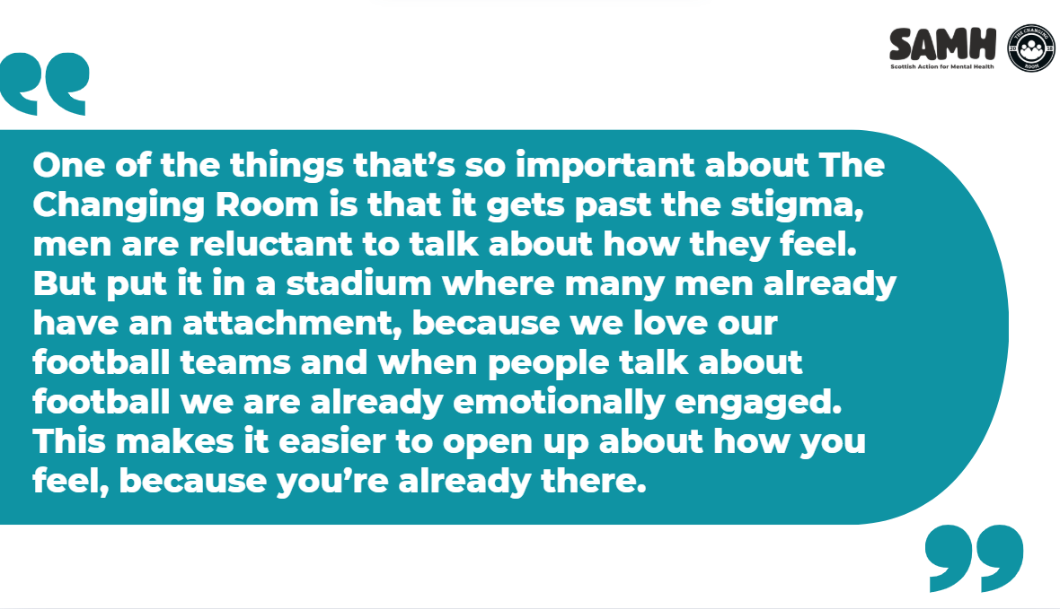

Slide 15
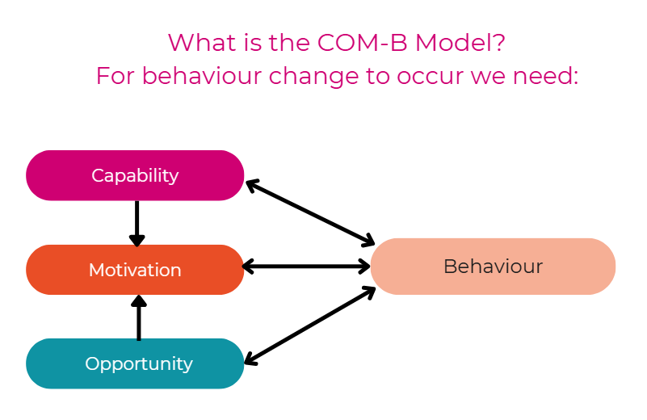

Slide 16
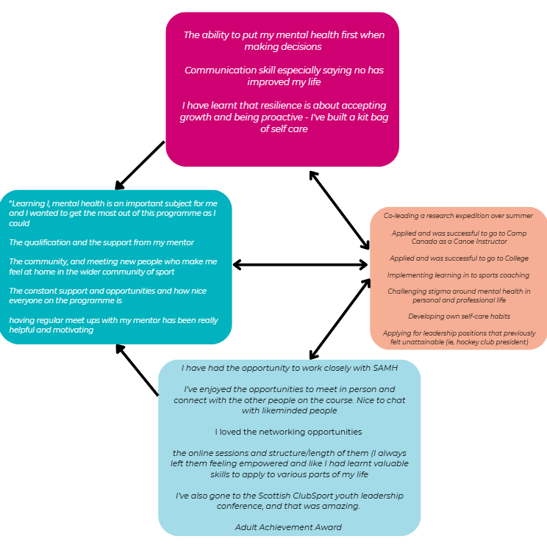
Young Women in Sport Leadership:
Participant Feedback
Influencing factors
We look at people’s capabilities.
We seek to create opportunities.
We examine what motivates us.
We bring these dynamics together with the aim to influence our behaviour and promote healthy, lasting change.

Slide 17
In your groups, consider the following scenario….
Meet Sam… Sam is in their middle years and has spent much of their career in a demanding and emotionally taxing environment. After experiencing significant mental health challenges, Sam took time off work. Their absence and the reason behind it became widely known among colleagues and within their community.
Upon returning to work, Sam encountered various forms of stigma—from subtle changes in how people spoke to them, to being excluded from key conversations and decisions. This stigma didn’t just affect Sam at work—it began to shape how they interacted with friends, family, and their wider community. Sam became more withdrawn, short-tempered, and angry. Their behaviour changed, and they felt increasingly isolated.
After a heartfelt conversation with their partner, Sam decided to seek support. They began looking for a community group where they could feel safe, understood, and accepted. However, Sam is deeply concerned about whether they will be judged again, misunderstood, or treated differently because of their mental health history.

Slide 18
Discussion Prompt: How Can We Best Support Sam?
In your groups, consider:
What kinds of stigma might Sam be facing? (e.g., workplace stigma, self-stigma, community stigma)
How might stigma influence Sam’s behaviour and relationships?
What barriers might Sam face when seeking support?
What can individuals, groups, and organisations do to create safer, more inclusive spaces for people like Sam?
How can we challenge our own assumptions and biases to better support someone like Sam?

Slide 19
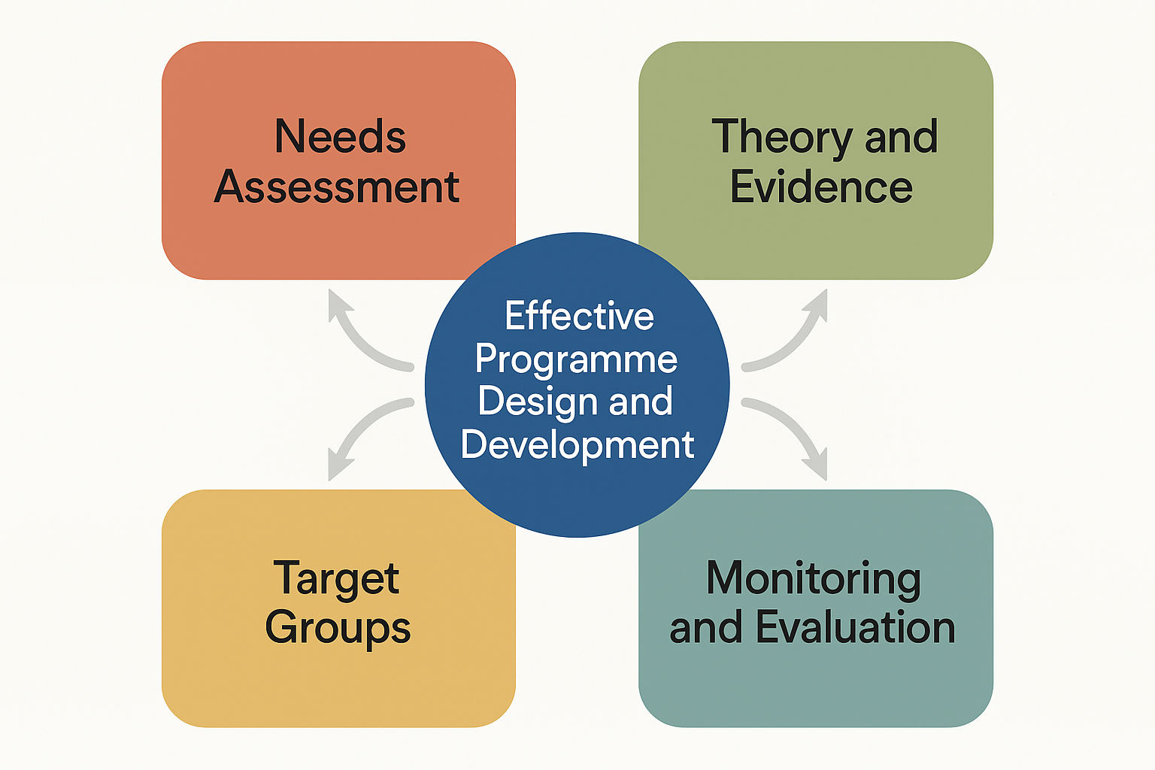
Programme Design
Need
Engagement
Codesign
Test
Change

Slide 20
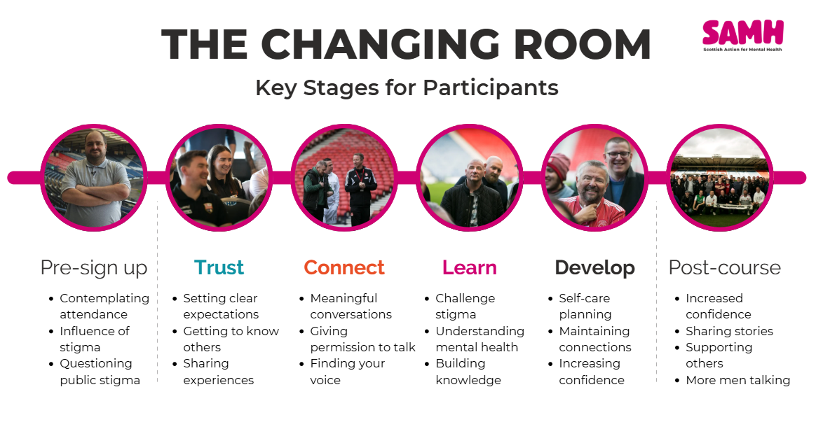
Programme Design

Slide 21
The influence of Stigma on participants
Withdrawal
Confidence
Anger
Shame
Fear
Relationships
Isolation

Slide 22
In your groups
Consider what can what might be helpful to demonstrate change relating to stigma on an individual
What tools can we use to show this?
What are the different ways we can gather evidence?
What do we tell this to others?
Put the ideas/experiences on the flip chart paper.
Evaluation:
How can we demonstrate change?

Slide 23
How do we track change?
Monitoring and Evaluation
Storytelling
Talking heads
Quotes
Map Change
Peer Led Groups
Peer Led facilitors
Starting to look at the Ripple Effect

Slide 24
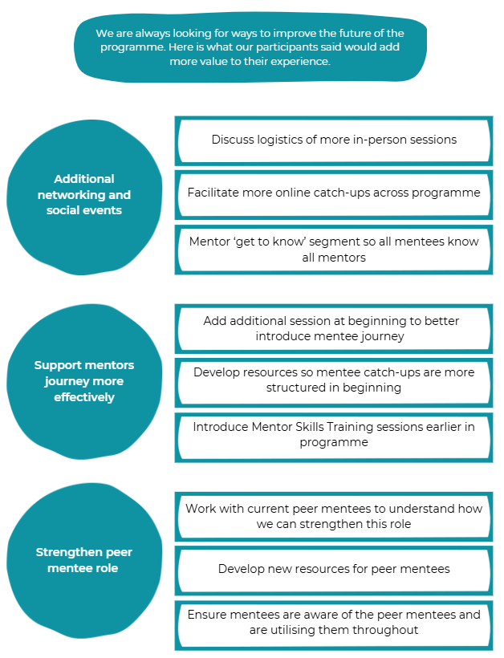
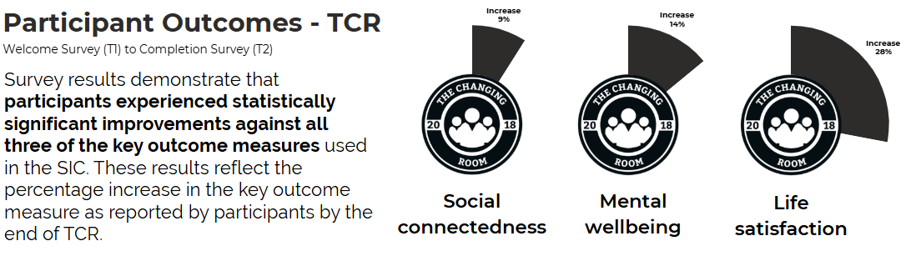
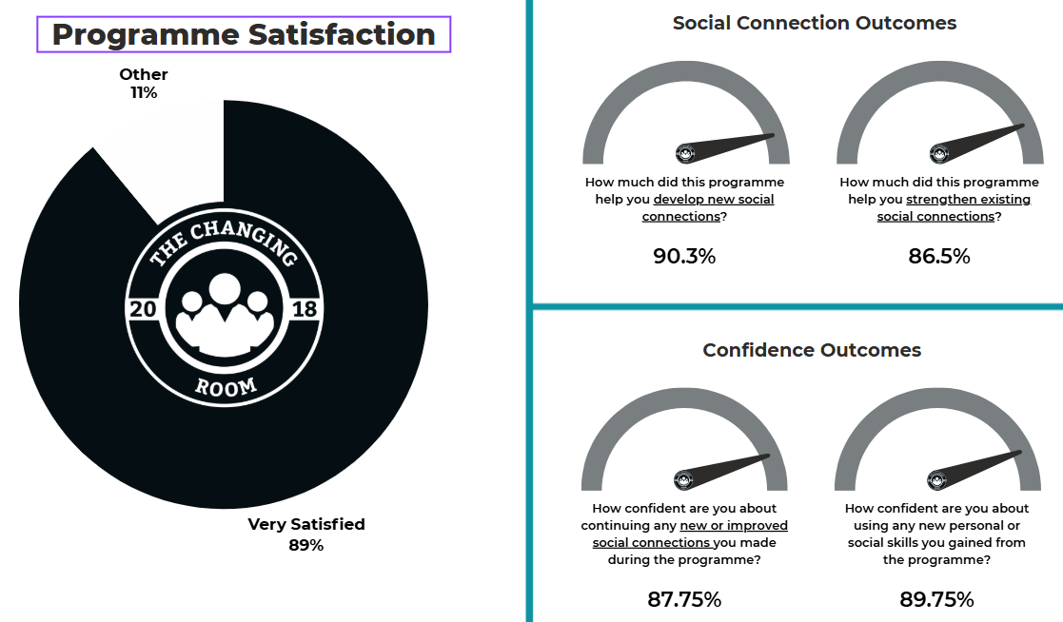
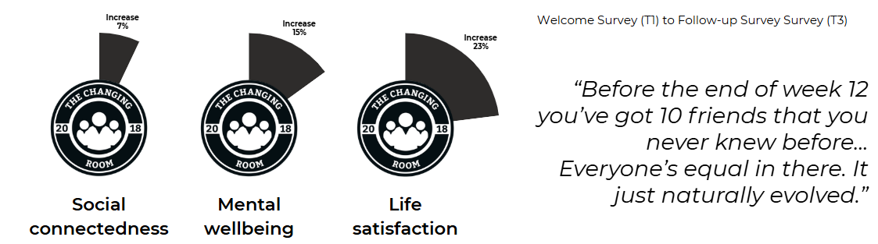
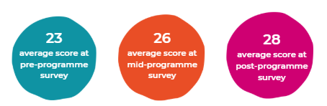

Slide 25
Thank You!
Christopher.Nicolson@samh.org.uk
Robert.Nesbitt@samh.org

