Slide 1

Tackling intersectional stigma in mental health
Sahaj Kamra (See Me), Rachel Gray (See Me)
and Mahasin Ahmed (Founder, Exhale)
Notes:
Tackling intersectional stigma in mental health
We are Sahaj Kamra, Rachel Gray and Mahasin Ahmed (Founder of Exhale)

Slide 2

In this session...
Introduce intersectional stigma and anti-stigma interventions as essential for reducing stark inequities in mental health.
Raise awareness of the legacy of the historic roots of intersectional stigma and discrimination and how these manifests in Scotland today, deepening inequalities.
Pilot our new 'The service will see you now' boardgame on navigating the mental healthcare services
Explore frameworks and community-led action at different levels to counter intersectional stigma and discrimination.
Notes:
Introduce intersectional stigma and anti-stigma interventions essential for reducing stark inequities in mental health.
Raise awareness of the legacy of the historic roots of intersectional stigma and discrimination and how these manifests in Scotland today, deepening inequalities.
Pilot our new 'The service will see you now' boardgame on navigating the mental healthcare services. You will see this set up on the tables in front of you.
Explore frameworks and community-led action at different levels to counter intersectional stigma and discrimination.

Slide 3

Safer Space Agreement
Keep yourself safe ​
​Share only information that is yours to share – take time out if you need to.​
​
Respect ​
​Everyone has different views and experiences. Treat people how you would like to be treated. We are not here to debate if stigma is real.​
​
Confidentiality ​
​What’s shared here by people shouldn’t be discussed outside.​
​
Self-awareness​
​Acknowledging there is different power dynamics in the room and being mindful of what we are all bringing with us into the session and impact on others.
Notes:
Safer space agreement and content warning
2MINS
Due to the content of the workshop, we start by agreeing a Safer Space Agreement and Content Warning Notice.
The session will include descriptions of stigma and discrimination including stigmatising language and discriminatory practices across gender, race, sexuality, disability, and socio-economic deprivation.
We agree to keep ourselves safe during this session - We will share only information that is ours to share – and please do take time out if you need to.
We will show respect for the fact that everyone has different views and experiences. And we'll treat people in the way that we would like to be treated.
We agree to respect confidentiality with the understanding that what is shared here by people shouldn’t be discussed outside of this session.
And finally, We acknowledge that there are different power dynamics in the room and we are mindful of what we are all bringing with us into the session and impact on others.
Is everyone happy to agree to this?

Slide 4

Language and Terminology
  We use terminology and language that communities of people use themselves.
  Language and terminology that marginalised people use to describe themselves changes and evolves.
  We adapt our language to mitigate harm and to accommodate inclusion.
Notes:
Language and terminology
1 MINS
Our language and terminology use are part of creating and supporting safer spaces.
Language is a key aspect in the perpetuation of mental health stigma and it has a powerful role in shaping perceptions.
When particular groups are described in negative or demeaning ways, it reinforces stereotypes, biases, and social inequalities.
Marginalised communities have actively reclaimed and redefined language that has been used to stigmatise or oppress them.
In this session we will use terminology and language that communities of people use themselves.

Slide 5

Introduction
Your name and your role (if you'd like to)
One word to say how you are feeling
Notes:
Your name and your role (if you'd like to)
One word to say how you are feeling

Slide 6
Energizer
‘Common Ground, Different Ground’
Raise a hand if these statements apply to you
Notes:
'Common Ground, Different Ground’
Raise a hand if these statements apply to you

Slide 7

Definitions
Stigma - a social process that involves the damaging labelling, stereotyping, and exclusion of individuals or groups based on perceived differences that deviate from dominant social norms.
Discrimination - a key part of stigma. It is the inequitable or prejudicial treatment of individuals or groups based on their stigmatised identities. It can be intentional (explicit prejudice) and unintentional (underlying in organisations and systems).
Notes:
When we talk about mental health stigma and discrimination – what exactly do we mean?
We define Stigma as a social process that involves labelling, stereotyping, and the exclusion of individuals or groups based on perceived differences that deviate from dominant social norms across gender, race, sexuality, ethnicity, disability, class, and wealth.
Dominant social norms are the standards and reinforced rules, expectations, and behaviours that define what is considered "normal," appropriate, or desirable within a given society or group.
We define Discrimination as a key part of stigma.
Discrimination can be intentional (explicit prejudice) and unintentional (underlying in organisations and systems).
It can be defined as the inequitable or prejudicial treatment of people or groups based on their stigmatised identities.
Discrimination can be named as:
Sexism & Misogyny
Transphobia
Racism
Xenophobia
Homophobia
Ableism
and
Classism

Slide 8

What is the purpose of stigma?
Keeping people "in" - enforce dominant social norms and values​
Keeping people "down" - maintain privileged group advantage
​Keeping people "away" - avoid 'disease' or perceived threat
Phelan, Link and Dovidio (2008)
Notes:
So what is the purpose of stigma? Why stigmatise people?
Parker and Aggleton (2008) argue that Stigma is a strategically deployed social process.
Phelan, Link and Dovidio (2008) define three functions of health-related stigma:
norm enforcement (keeping people in)
domination (keeping people down)
and "disease" avoidance (keeping people away)
As such mental health stigma causes and perpetuates inequality, discrimination, and social isolation.
References
Parker R, Aggleton P. HIV and AIDS-related stigma and discrimination: a conceptual framework and implications for action. Social Science & Medicine. 2003;57:13–24 cited by Stuber J, Meyer I, Link B. Stigma, prejudice, discrimination and health. Soc Sci Med. 2008 Aug;67(3):351-7.
Phelan, Jo C., Link, Bruce G., & Dovidio, John F. (2008). Stigma and Prejudice: One Animal or Two? Social Science & Medicine, 67(3), 358-367.

Slide 9

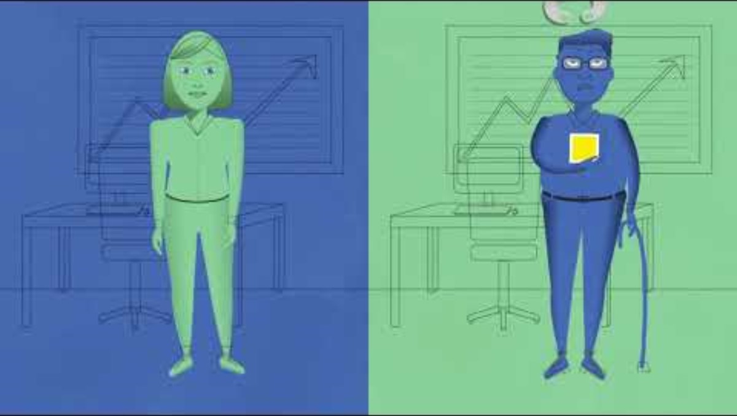
Intersectionality
Notes:
Intersectionality Video
youtu.be/O1islM0ytkE [2m29s]
Intersectionality, originates in Black feminism and critical race studies, it is a lens through which we can seek to understand the complex nature of identity, health, social relationships, and power that plays out within human interaction and experiences (Crenshaw 1989).
This video has helped us to think differently about how to achieve our goal to challenge stigma and discrimination related to mental health across the entire population.

Slide 10
Intersectional Stigma
Multiple forms of stigma mutually shape the lived experiences and opportunities of groups who are marginalised, and create distinct disadvantages, which cannot be understood in isolation from one another.
(Sievwright et al., 2022)​
Notes:
Multiple forms of stigma mutually shape the lived experiences and opportunities of groups who are marginalised, and create distinct disadvantages, which cannot be understood in isolation from one another (Sievwright et al., 2022).
Mental health stigma and discrimination is not experienced equally by all people.
Mental health stigma and discrimination intersects with identity-based prejudice across people's race, gender, ethnicity, disability, wealth, and sexuality.
It intersects with racism, misogyny, ableism, classism, heteronormativity, and anti-immigration.

Slide 11
Intersectional nature of Stigma
Stigma intersects with identity-based prejudice.
It intersects with stigmatised health and living conditions.
Deeply stigmatised mental health conditions are often linked to discrimination against people with other marginalised identities.
Notes:
Stigma intersects with identity-based prejudice.
It intersects with stigmatised health and living conditions.
Deeply stigmatised mental health conditions are oftenlinked to discrimination against people with othermarginalised identities.

Slide 12


Example: LGBT+ mental health
LGBT+ people face higher rates of depression, anxiety disorders and suicidality than the general population.
Despite a higher need for support, stigma and discrimination creates barriers for LGBT+ people to access vital services.
24% of LGBT people have faced discrimination in healthcare settings
37% of trans people avoid seeking healthcare for fear of discrimination
(Stonewall Scotland 2019)
Notes:
Activity 2: Assumptions and support
15 minutes
Small group discussion [5 minutes]
Choose one of the case studies and reflect on these questions:
What assumptions have been made about the people in the case studies?
How might these assumptions impact someone's access to support?
Group feedback [10 minutes]
Facilitate the discussion using the suggested prompts:
Racial Inequality Case Study
Assumptions
The counsellor made assumptions about family/cultural attitudes to mental health issues
The counsellor didn't explore the person's individual perspective – only an assumed family/cultural perspective
There was a lack of recognition of racism, micro-agressions, and cultural identity shape mental health
The counsellor used the assumption of a 'universal' mental health experience rather than acknowledging racialised experiences
This may impact the person by:
Eroding their trust in the service
Miss the root cause of mental distress
Reduce the effectiveness of the therapeutic treatment
Reinforce racialised mental health inequalities
LGBT Youth Case Study
Assumptions
Rather than seeing them as a whole person their trans identity is assumed as the only source of their distress
Ignoring other contributing factors to the person's mental health issues
Making the assumption that transitioning will resolve their health concerns
This may impact the person by:
Creating barriers to adequate care
Create feelings of invalidation and frustration with the service
Cause them to anticipate poor treatment in the future
Reinforce stigma by placing the blame on the person's trans identity
Mental Welfare Commission, Racial Inequality and Mental Health in Scotland A call to action, September 2021
LGBT Youth Scotland (2022) Life in Scotland for LGBT young people

Slide 13
Assumptions and support: Lived experience accounts
“[…] my counsellor did not understand my family culture or religion and wanted to attribute parts of my condition to my parents’ behaviour although I didn't feel particularly affected by those aspects. She also didn't have any sympathy or awareness about racial trauma and how micro aggressions work or how we experience everyday racism which has an impact on our wellbeing.”
Racial Inequality in Scotland, MWC (2021)
“Many mental health services…have implied that all of my issues link back to my trans identity and that if I fully transition, they will no longer be an issue for me. This is a misunderstanding and has caused me many frustrations when trying to access services.”
​Life in Scotland for LGBT young people, LGBT Youth Scotland (2022)​
Notes:
Activity: Assumptions and support
15 minutes
Small group discussion [5 minutes]
Choose one of the case studies and reflect on these questions:
What assumptions have been made about the people in the case studies?
How might these assumptions impact someone's access to support?
Group feedback [10 minutes]
Facilitate the discussion using the suggested prompts:
Racial Inequality Case Study
Assumptions
The counsellor made assumptions about family/cultural attitudes to mental health issues
The counsellor didn't explore the person's individual perspective – only an assumed family/cultural perspective
There was a lack of recognition of racism, micro-agressions, and cultural identity shape mental health
The counsellor used the assumption of a 'universal' mental health experience rather than acknowledging racialised experiences
This may impact the person by:
Eroding their trust in the service
Miss the root cause of mental distress
Reduce the effectiveness of the therapeutic treatment
Reinforce racialised mental health inequalities
LGBT Youth Case Study
Assumptions
Rather than seeing them as a whole person their trans identity is assumed as the only source of their distress
Ignoring other contributing factors to the person's mental health issues
Making the assumption that transitioning will resolve their health concerns
This may impact the person by:
Creating barriers to adequate care
Create feelings of invalidation and frustration with the service
Cause them to anticipate poor treatment in the future
Reinforce stigma by placing the blame on the person's trans identity
Mental Welfare Commission, Racial Inequality and Mental Health in Scotland A call to action, September 2021
LGBT Youth Scotland (2022) Life in Scotland for LGBT young people

Slide 14
Capitalism and white supremacy.
Enlightenment ideas of average as ‘normal’ and normal as ‘good’.
Colonialism relies on the shared belief that certain groups are inherently morally, physically and intellectually "inferior".
Eugenics provided the pseudo-scientific rationale for colonial violence and the idea of "socially undesirable".
Scientific racism was embraced by the psychiatric establishment of 19th and early 20th century.
The systems of power and supremacy behind
stigma and discrimination

Slide 15

'Hysteria' diagnosis has pathologised women resisting patriarchal inequality since 2nd century BC (Carta et al., 2012).
Homosexuality cited as mental illness in the DSM until APA declassification in 1973.
World Health Organisation re-categorised being transgender in the International Classification of Diseases (ICD-11) in 2019.
Non-consensual sterilisation of people with learning disabilities and mental ill health into the latter half of the 20th-century.
The 'Great Confinement' conflated poverty and mental ill health and positioned people as moral failures with degenerate behaviour.
Intersectional nature of stigma throughout
history
Notes:
'Hysteria' diagnosis has pathologised womenresisting patriarchal inequality since 2nd century BC(Carta et al., 2012).
Homosexuality cited as mental illness in the DSMuntil APA declassification in 1973.
World Health Organisation re-categorised beingtransgender in the International Classification ofDiseases (ICD-11) in 2019.
Non-consensual sterilisation of people with learningdisabilities and mental ill health into the latter halfof the 20th-century.
Intersectional nature of stigma throughout history
The 'Great Confinement' conflated poverty andmental ill health and positioned people as moralfailures with degenerate behaviour.

Slide 16
Black men 10 times more likely to receive a diagnosis of a psychotic disorder than white men [UK-wide] (Frazer-Carrol, 2023).
Disproportionately high incidence of mental health problems (not severe and enduring mental illness) experienced by LGBT people due to ‘minority stress’ not being LGBT. (Equality Network; LGBTH&WB; LGBT Youth Scotland, Scottish Trans; Stonewall, 2018).
“Black people and mixed-race people are more likely to be seen as a greater risk to ‘self and others’ than to themselves […] The greater perception of risk extends particularly towards Black women” (MWC, 2021).
Disabled people often experience diagnostic overshadowing (GDA, 2022)
People living in poverty, more likely to be diagnosed with mental illness – conflating symptoms – process is racialised and gendered (Mills, 2015).
People with severe and enduring mental illness experience stigma and discrimination across 14 life areas (SMISS, 2022)
Present-day inequalities

Slide 17
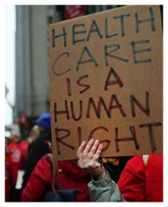
Social movements, resistance and change
Scottish Union of Mental Patients 1971-72 Hartwood Hospital North Lanarkshire
Dr. John Fryer's 1972 Speech/community social action agitated for change to remove homosexuality from the DSM
Mental Health Act 1983: Amendments to the Act, influenced by advocacy from the disability justice movement, have aimed to improve patient rights, ensure better safeguards, and promote more humane treatment practices
Notes:
Social movements, resistance and change
Scottish Union of Mental Patients 1971-72Hartwood Hospital North Lanarkshire
Dr. John Fryer's 1972 Speech/community social action agitated for change to remove homosexuality from the DSM
Mental Health Act 1983: Amendments to the Act, influenced by advocacy from the disability justice movement, have aimed to improve patient rights, ensure better safeguards, and promote more humane treatment practices

Slide 18
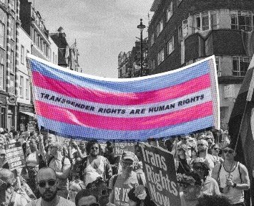
Social movements, resistance and change
2019 - Trans advocacy groups pressured WHO to re-categorise being transgender in the International Classification of Diseases (ICD-11) as no longer a ‘disorder’’ (WHO, n.d.)
2021 & 2022 - Black Lives Matter movement pressured American Psychiatric Association and Royal College of Psychiatrists to apologise for institutional racism
Notes:
Social movements,resistance and change
2019 - Trans advocacy groupspressured WHO to re-categorisebeing transgender in theInternational Classification ofDiseases (ICD-11) as no longer a‘disorder’’ (WHO, n.d.)
2021 & 2022 - Black Lives Mattermovement pressured AmericanPsychiatric Association and RoyalCollege of Psychiatrists to apologisefor institutional racism

Slide 19

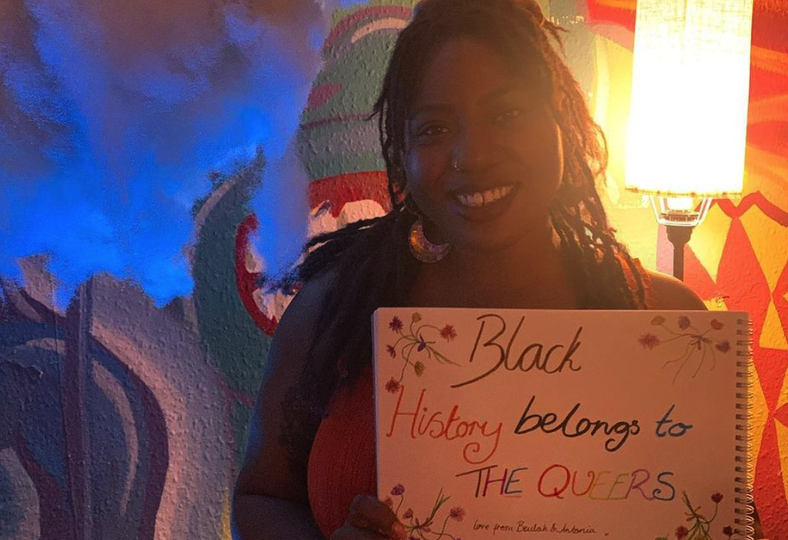
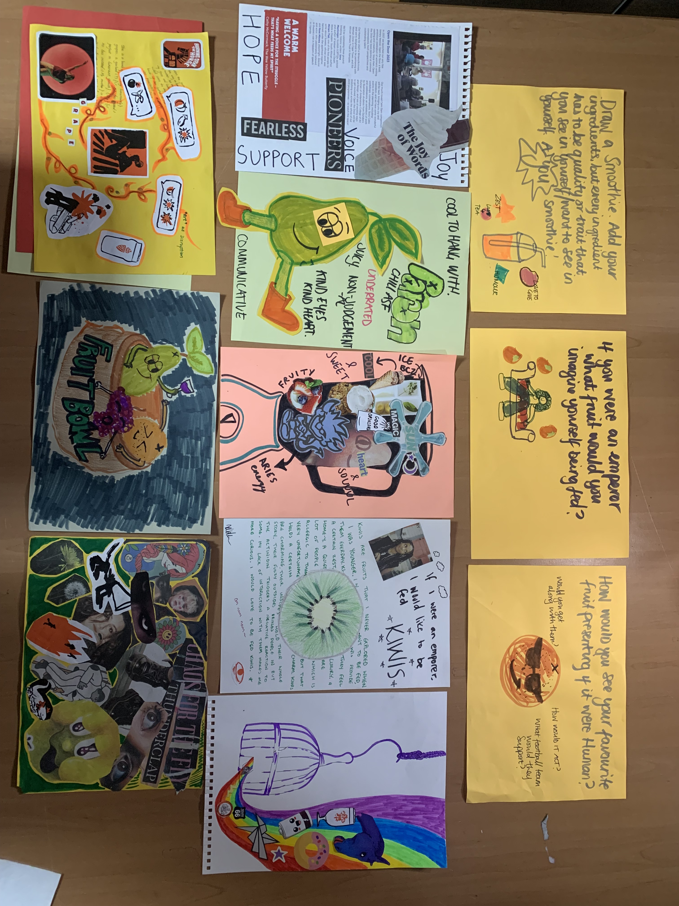
Working with communities, Example from Exhale.Group CIC
Exhale works with LGBT+ people from racialised backgrounds – a group that experiences intersectional and 'double' discrimination based on both race and sexuality/gender identity.
These experiences can cause a lack of sense of belonging, poorer wellbeing and self-esteem and isolation.
Exhale provides an 'exclusive' inclusive space for LGBT+ BPoC to be with one another and explore issues and experiences in a safe and supported environment.
Sometimes using creative practices, movement and fun activities as a catalyst to allow people to open up and explore their emotions.
"Before I think I was really ashamed of my queerness...that's why you seek communities like [Exhale]… I think now my outlook on being queer is that it's more of a superpower"
Notes:
Exhale works with LGBT+ people from racialised backgrounds – a group that experiences intersectional and 'double' discrimination based on both race and sexuality/gender identity.
These experiences can cause a lack of sense of belonging, poorer wellbeing and self-esteem and isolation.
Exhale provides an 'exclusive' inclusive space for LGBT+ BPoC to be with one another and explore issues and experiences in a safe and supported environment.
Sometimes using creative practices, movement and fun activities as a catalyst to allow people to open upand explore their emotions.

Slide 20
What works?
Community connectedness
Peer support
Social contact
Protest
Community leadership
Education
Collective action

Slide 21
Intersectional stigma
reduction intervention principles (Sievwright et al. 2022)
Recognise and name how systems of power intersect to affect individual experiences and fuel stigma
Aim to dismantle systems of power and oppression, and mitigate the harms
Ensure community leadership and meaningful engagement
Support collective action, cohesion, and resistance to address the intersecting axes of inequities

Slide 22
SCIP Framework: Stigma and discrimination operate at multiple levels and involve complex social processes
Political ideologies, policies, and legislation determine the societal conditions that constrain or enable our access to opportunities, resources, and wellbeing.
^{intersecting}
Structural Level
Damaging ideologies, social norms, and labelling influence interpersonal stigma, discrimination and exclusion in our interactions with other people.
Cultural/
Societal Level
Institutional
Level
Opportunities and resources that determine our wellbeing are established and formalised within institutional and organisational systems in policies and practices.
Personal Level
People with stigmatised identities, mental health conditions and/or coping mechanisms internalise negative societal beliefs about themselves.
Model inspired by the SCIP analysis available at: Pérez Portilla, K. (2016). Redressing Everyday Discrimination. ​The weakness and potential of antidiscrimination law. UK: Routledge. pp. 61-70.

Slide 23
The System Will See You Now
A systems-thinking game exploring stigma, access, and equity in mental health services
Notes:
And so now we are going to play our new systems-thinking game exploring stigma, access, and equity in mental health services
The System Will See You Now

Slide 24
The System Will See You Now
A social stratification game - the way systems of power in our society organises people into ranked layers based on factors like wealth, power, ability, education, and social status.
An interactive learning exercise, using a modified version of the game Monopoly, intended to stress the structural nature of social inequality and to stimulate reflection and discussion.
You will 'experience' different levels of social stratification (SCIP) within mental health services.
People are not "hard to reach" - the system (the service) is hard to reach (hard to access and hard to receive quality of care).
Notes:
A social stratification game - Social stratification is the way a society organises people into ranked layers based on factors like wealth, power, education, and social status.
An interactive learning exercise, using a modified version of the game Monopoly, intended to stress the structural nature of social inequality and to stimulate reflection and discussion
The primary focus of this game is to help you experience different levels of social stratification (inequity) with mental health services
We don't focus on individuals and their characteristics – People are not hard to reach -the system is hard to reach (hard to access and hard to receive quality of care).
Further info at:
Coghlan, C. L., & Huggins, D. W. (2004). “That’s Not Fair!”: A Simulation Exercise in Social Stratification and Structural Inequality. Teaching Sociology, 32(2), 177-187. https://doi.org/10.1177/0092055X0403200203 (Original work published 2004)

Slide 25
The System Will See You Now
Informed by evidence from:
Intersectional communities
Mental health service practitioners
The regulator (Mental Welfare Commission)
Academia (Sociology and Public Health)
Government and institutional frameworks and guidance
2 Core Areas
Access to services/care​
Is the service physically, culturally, linguistically, and financially reachable by all people?
​
2. Quality of service/care​
How do intersectional communities themselves define clinical care that is safe, effective and respectful?
Notes:
And so now we are going to play our new systems-thinking game exploring stigma, access, and equity in mental health services
The System Will See You Now
The game is embedded in recent research informed by:
Community evidence
MHS Practitioner evidence
Regulator evidence
Academic evidence
Government and institutional frameworks and guidance
Access to services/care
Is the service physically, culturally, linguistically, and financially reachable by allpeople?
Quality of service/care
How do intersectional communities themselves define clinical care that is safe,effective and respectful?

Slide 26
The 8 Core Good Anti-Stigma Practice Principles align with Intersectional stigma reduction intervention principles Sievwright et al., 2022
1. Recognise and name how systems of power intersect to affect individual experiences and fuel stigma
Intersectionality and Cultural Humility and Safety
(Anti stigma - Equity, identity, social justice)
Workforce Capacity, Training, and Support
(Anti stigma - Skills, capacity, support systems)
2. Aim to dismantle systems of power and oppression, and mitigate the harms
Resource Allocation and Sustainable Investment
(Anti-stigma - Sustainable funding; equitable, needs-based distribution)
Access, Equity, and Service Improvement
(Anti stigma - Practical access, structural fairness)
Anti-Stigma and Inclusion
(Anti stigma - Language, empowerment, bias reduction)
Person-centred, rights-based, trauma-informed care
(Anti stigma - Autonomy, dignity, recovery)
Holistic, Non-Medical, and Community-Based Approaches
(Anti stigma - Non-clinical, whole-person, social and emotional support)
3. Ensure community leadership and meaningful engagement
Co-Production, Peer Involvement, and Empowerment
(Anti stigma - Shared power, lived experience)
Collaborative Leadership and Governance
(Anti-stigma - Decision-making, accountability)
4. Support collective action, cohesion, and resistance to address the intersecting axes of inequities
Notes:
8 Core Good Anti-Stigma Practice Principles align with Intersectional stigmareduction intervention principles Sievwright et al., 2022
Let's play -
The set-up:
4 teams at each table (1 main player and 3 supporters)
We will do 1 full 'round' of the board
Each board has a banker and facilitator – Rachel lead this team's game and Sahaj and Mahasin will lead team 2's game.

Slide 27
Action mapping
What action would you take and which level?

Slide 28
Stigma Levels
Examples
Actions
Structural
Cultural/Social
Institutional
Personal

Slide 29
Evaluation and Thank You

Slide 30
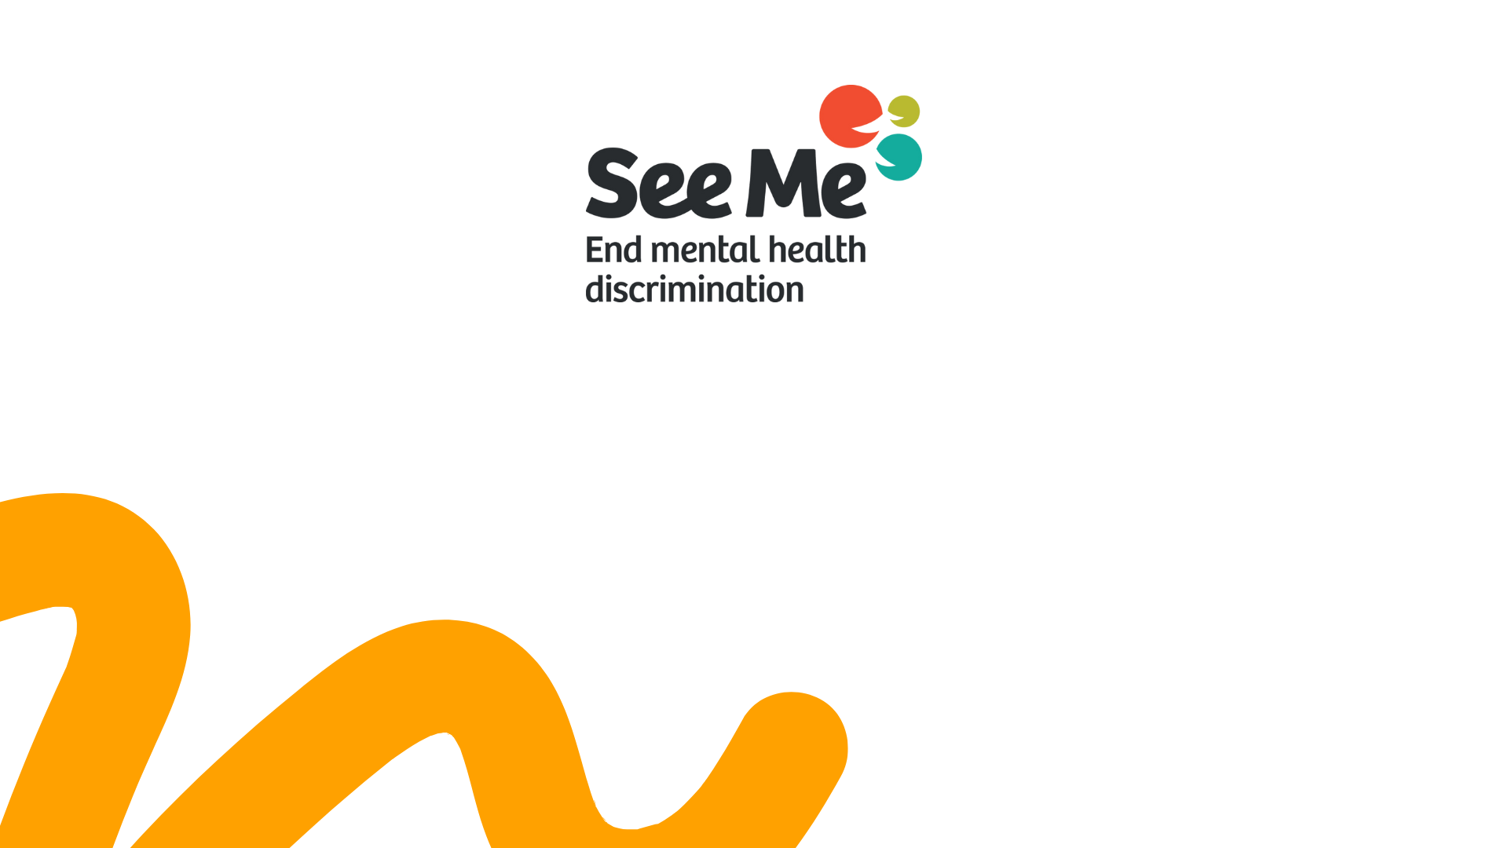
Thank You
seemescotland.org

